Slide 1
Soil organic carbon and pH
Dr. H. Deb Barma
Women’s College, Agartala

Slide 2
The second major component of soils is organic matter produced by organisms. The total organic matter in soil, except for materials identifiable as undecomposed or partially decomposed biomass, is called humus. This solid, dark-coloured component of soil plays a significant role in the control of soil acidity, in the cycling of nutrients, and in the detoxification of hazardous compounds. Humus consists of biological molecules such as proteins and carbohydrates as well as the humic substances (polymeric compounds produced through microbial action that differ from metabolically active compounds).

Slide 3
What is soil organic carbon?
Soil organic carbon is a measureable component of soil organic matter. Organic matter makes up just 2–10% of most soil's mass and has an important role in the physical, chemical and biological function of agricultural soils.
Organic matter contributes to nutrient retention and turnover, soil structure, moisture retention and availability, degradation of pollutants, and carbon sequestration (removal or separation).

Slide 4
How is soil organic carbon different to soil organic matter?
Soil organic carbon (SOC) refers only to the carbon component of organic compounds. Soil organic matter (SOM) is difficult to measure directly, so laboratories tend to measure and report SOC.

Slide 5
What is soil organic matter?
SOM is composed mainly of carbon, hydrogen and oxygen, and has small amounts of other elements, such as nitrogen, phosphorous, sulfur, potassium, calcium and magnesium contained in organic residues. It is divided into ‘living’ and ‘dead’ components and can range from very recent inputs, such as stubble (stumps of grains and other stalks left in the ground when the crop is cut), to largely decayed materials that are thousands of years old. About 10% of below-ground SOM, such as roots, fauna and microorganisms, is ‘living’ (Figure 1).

Slide 6
SOM exists as 4 distinct fractions which vary widely in size, turnover time and composition in the soil (Table 1):
dissolved organic matter
particulate organic matter
humus
resistant organic matter.

Slide 7
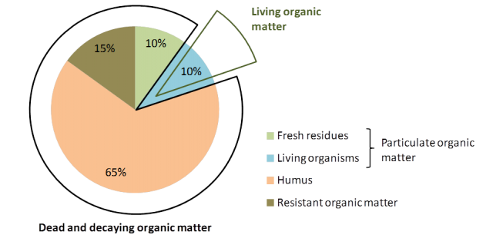
Figure 1 Most soil organic matter is dead or decaying, with living organisms making up about 10% of the soil organic matter pool

Slide 8
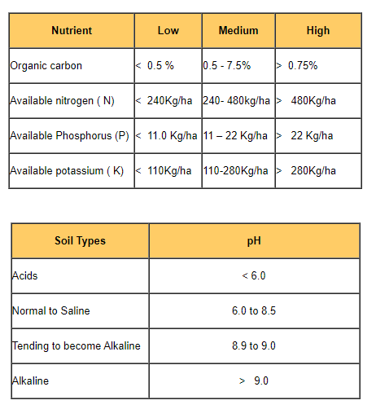
Rating chart for soil test data
https://agritech.tnau.ac.in/agriculture/agri_soil_soilratingchart.html

Slide 9
Soil pH
Soil pH is a measure of the soil’s relative acidity or basicity. The pH scale ranges from 0 to 14. A pH of 7 is a neutral state, representing the value found in pure water. Values above 7.0 are basic, while values below 7.0 are acidic. The pH scale is logarithmic, meaning each unit has a 10-fold increase of acidity or basicity. Thus, compared to a pH of 7.0, a pH of 6.0 is ten times more acidic, and a pH of 5.0 is 100 times more acidic.

Slide 10
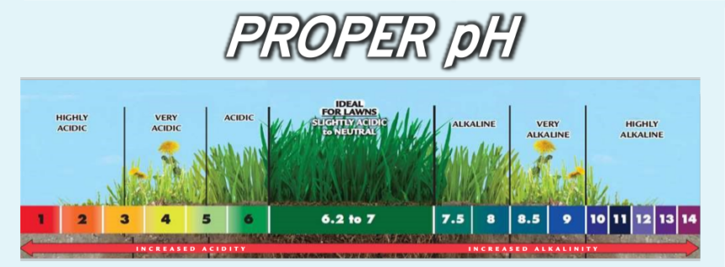
https://www.google.com/imgres?imgurl=https%3A%2F%2Fwww.jonathangreen.com%2Fwp-content%2Fuploads%2F2016%2F06%2FImportance-of-pH-scale-3-863x318.png&imgrefurl=https%3A%2F%2Fwww.jonathangreen.com%2Fimportance-soil-ph.html&tbnid=RCHMrmU0eD-UhM&vet=12ahUKEwjA1Zyx0KXyAhX8hUsFHT_cDW8QMygBegUIARC2AQ..i&docid=iHIA4c4zyJePNM&w=863&h=318&q=ph%20soil%20in%20soil&ved=2ahUKEwjA1Zyx0KXyAhX8hUsFHT_cDW8QMygBegUIARC2AQ

Slide 11
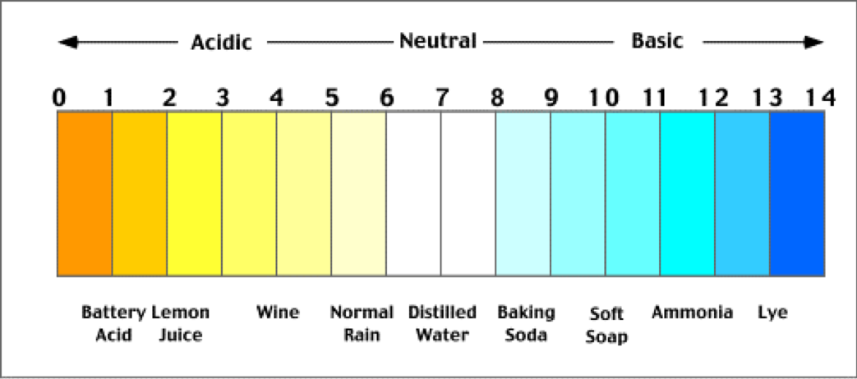
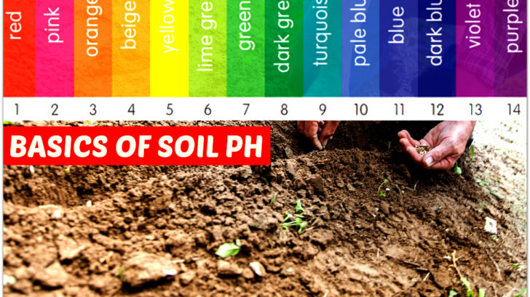

Slide 12
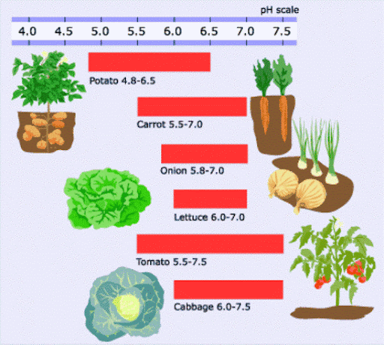

Slide 13
Nutrient Availability and pH
The optimum pH for a plant varies with organic matter content and plant type. Plant nutrient availability is strongly tied to the pH in the soil solution.
Decreasing soil pH directly increases the solubility of the plant nutrients manganese (Mn), zinc (Zn), copper (Cu), and iron (Fe). Acidic soils make these nutrients more available.

Slide 14
Adjusting pH
If the soil pH is too basic for the desired plant, incorporating an acidic soil amendment such as pine bark or compost, or applying elemental sulfur, will lower soil pH. Apply sulfur with caution; too much can harm plants.
If the soil pH is too acidic, apply lime to raise the soil pH. There are two general classes of liming materials: calcitic (without magnesium) and dolomitic (with magnesium). Calcitic lime is composed of calcium carbonate (CaCO₃) and can be used on soils high in magnesium. Dolomitic lime is a mixture of calcium and magnesium carbonates (CaCO₃ and MgCO₃), which is the preferred liming material for soils low in magnesium.

Slide 15
Reference
https://www.britannica.com/science/soil/Soil-formation
https://www.agric.wa.gov.au/measuring-and-assessing-soils/what-soil-organic-carbon

