Slide 1
Soil Profile, Major Soil types of the World: Zonal, Azonal and Intrazonal
Dr. H. Deb Barma
Assistant Professor
Women’s College, agartala

Slide 2
Soil Profile
A soil profile is a display of vertical section from the ground surface down to the parent rocks. Thus a soil profile denotes the vertical distribution of soil components (e.g., the living organisms-flora and fauna-and organic matter, the inorganic minerals, the soil solution and the attributes of soil atmosphere, etc) and various associations of the properties of these components.
“Soil profile is defined as the vertical section of the soil from the ground surface downwards to where the soil meets the underlying rock.”

Slide 3
The soil is arranged in layers or horizons during its formation. These layers or horizons are known as the soil profile. It is the vertical section of the soil that is exposed by a soil pit. The layers of soil can easily be identified by the soil colour and size of soil particles. The different layers of soil are:
-Topsoil
-Subsoil
-Parent rock
Each layer of soil has distinct characteristics.
Soil profile helps in determining the role of the soil as well. It helps one to differentiate the given sample of soil from other soil samples based on factors like its colour, texture, structure, and thickness, as well as its chemical composition.

Slide 4
Properties
The soil profile is characterized by the following common properties:
On an average there is gradual decrease of organic matter, no. of living organisms, activity of living organisms etc. with increasing depth in soil profile.
The level of aeration of soil decreases from the surface downwards in the soil profile.
There is increase in the no. and variety of parent minerals from the surface downward in the soil profile upto the base of parent rocks.
There is no definite trend of increase or decrease in the content of soil water with depth because there is a lot of fluctuation in water content. As it is determined by-i. location of ground water, ii. Nature of movement of ground water, iii. Frequency and amount of rainfall, iv. Absorptive characteristics of different horizons of soil profile.

Slide 5
Layers of Soil
The soil profile is composed of a series of horizons or layers of soil stacked one on top of the other. These layers or horizons are represented by letters O, A, E, C, B and R.
The O-Horizon
The O horizon is the upper layer of the topsoil which is mainly composed of organic materials such as dried leaves, grasses, dead leaves, small rocks, twigs, surface organisms, fallen trees, and other decomposed organic matter. This horizon of soil is often black brown or dark brown in colour and this is mainly because of the presence of organic content.

Slide 6
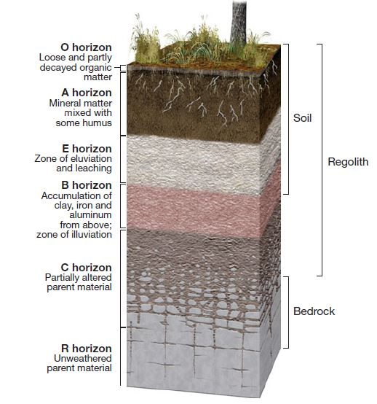
Image- Idealized soil profile.
https://digitallylearn.com/soil-profile-upsc-diagram-and-layers-geography-optional/

Slide 7
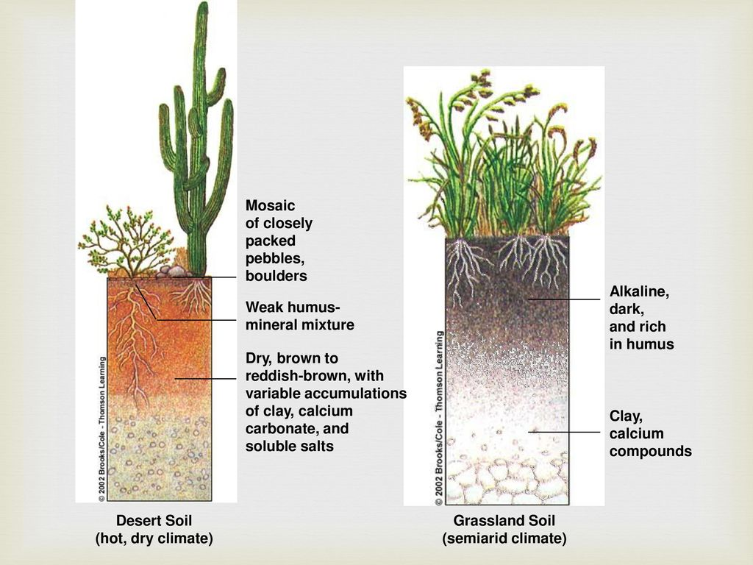
https://www.google.com/url?sa=i&url=https%3A%2F%2Fslideplayer.com%2Fslide%2F13053461%2F&psig=AOvVaw0mhDmhcKxTYam6xobcffO4&ust=1616919747748000&source=images&cd=vfe&ved=0CA0QjhxqFwoTCNC0gNiF0O8CFQAAAAAdAAAAABAQ

Slide 8
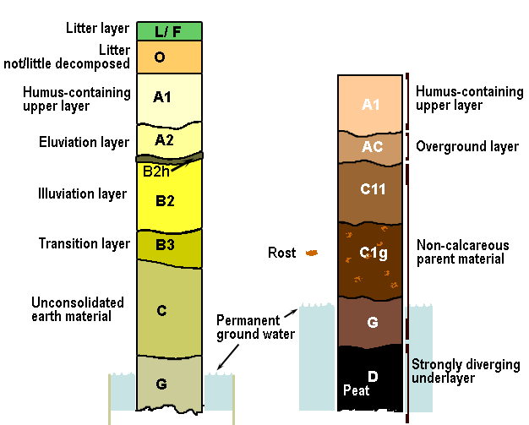
Hypothetical soil profiles with example of codes for horizons. L (or F): Litter (Förna = litter) 0: Litter layer of not or little decomposed plant material A: Eluviation layer, divided into: A1: Upper layer, dark in color, very rich in humus A2: Mineral layer relatively poor in clay material, iron, aluminium or all three due to leaching B: Illuviation horizon, divided into: B1: Gradual transition layer from A2 to B2 B2: Layer with maximal illuviation B3: Gradual transition from B2 to a C-horizon. C: Unconsolidated earth material. Not or only little weathered material g: g indicates the layers where iron, sedimented under anaerobe conditions, became oxidized later to ironoxide or rost G: G indicates the permanent non-aerate or poorly aerate parts of the soil, characterized by the blue-gray color of ironsulfide (FeS = pyrite). These layers are mostly in the deeper part of the profile.

Slide 9
The A-Horizon or Topsoil
This layer is rich in organic material and is known as the humus layer. This layer consists of both organic matter and other decomposed materials. The topsoil is soft and porous to hold enough air and water.
In this layer, the seed germination takes place and new roots are produced which grows into a new plant. This layer consists of microorganisms such as earthworms, fungi, bacteria, etc.

Slide 10
The E-Horizon
This layer is composed of nutrients leached from the O and A horizons. This layer is more common in forested areas and has lower clay content.
The B-Horizon or Subsoil
It is the subsurface horizon, present just below the topsoil and above the bedrock. It is comparatively harder and compact than topsoil. It contains less humus, soluble minerals, and organic matter. It is a site of deposition of certain minerals and metal salts such as iron oxide.
This layer holds enough water than the topsoil and is lighter brown due to the presence of clay soil. The soil of horizon-A and horizon-B is often mixed while ploughing the fields.

Slide 11
The C-Horizon or Saprolite
This layer is devoid of any organic matter and is made up of broken bedrock. This layer is also known as saprolite. The geological material present in this zone is cemented.
The R-Horizon
It is a compacted and cemented layer. Different types of rocks such as granite, basalt and limestone are found here.

Slide 12
Major Soil Types of the World
The US Department and Agriculture System of Soil Classification (USDA-1938) recognised 3 orders of soils, eg.-1. Zonal Soils, 2. Intra-zonal Soils, and 3. Azonal Soils.

Slide 13
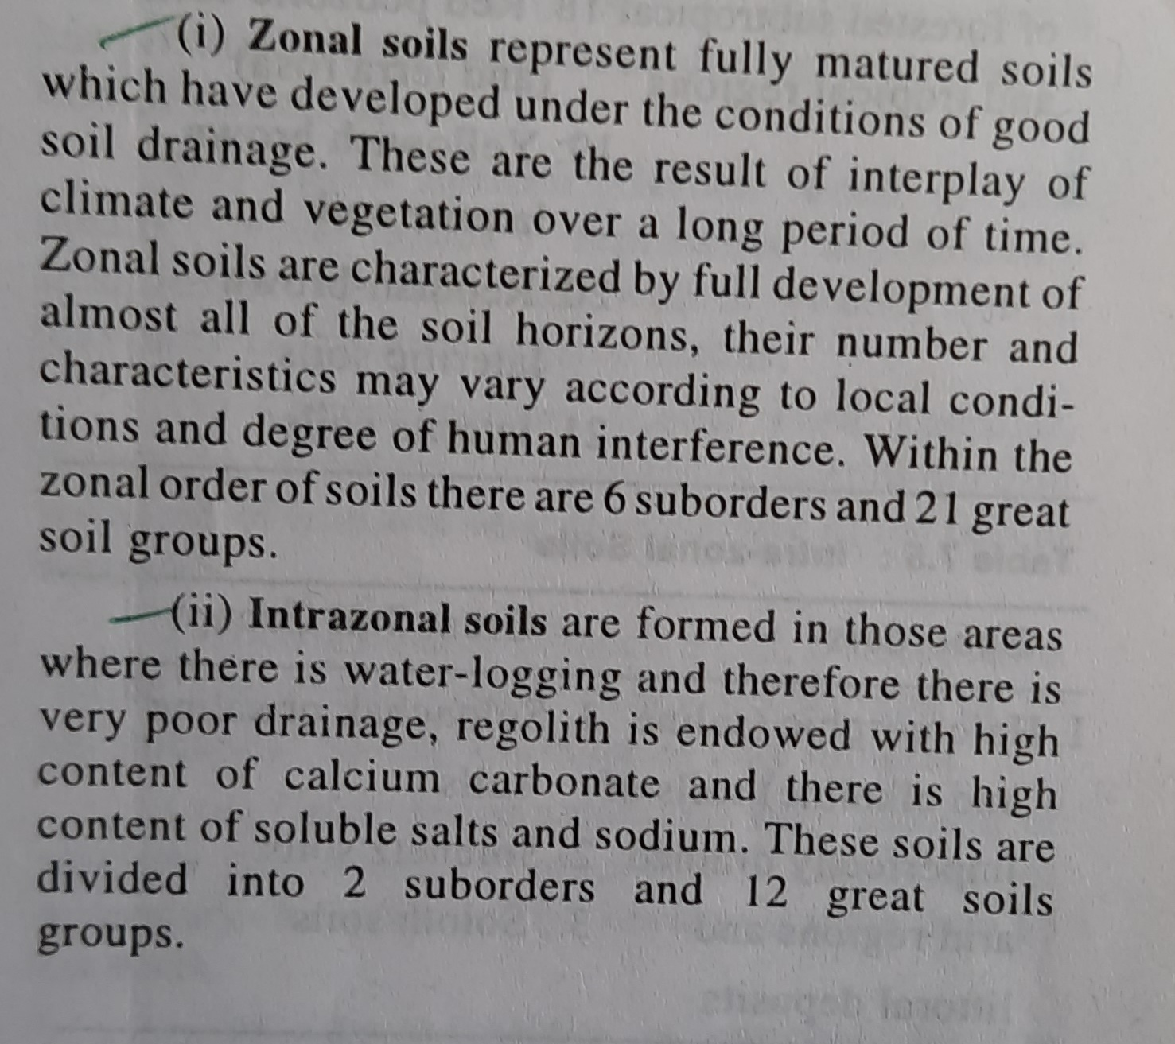

Slide 14
Zonal Soils

Slide 15
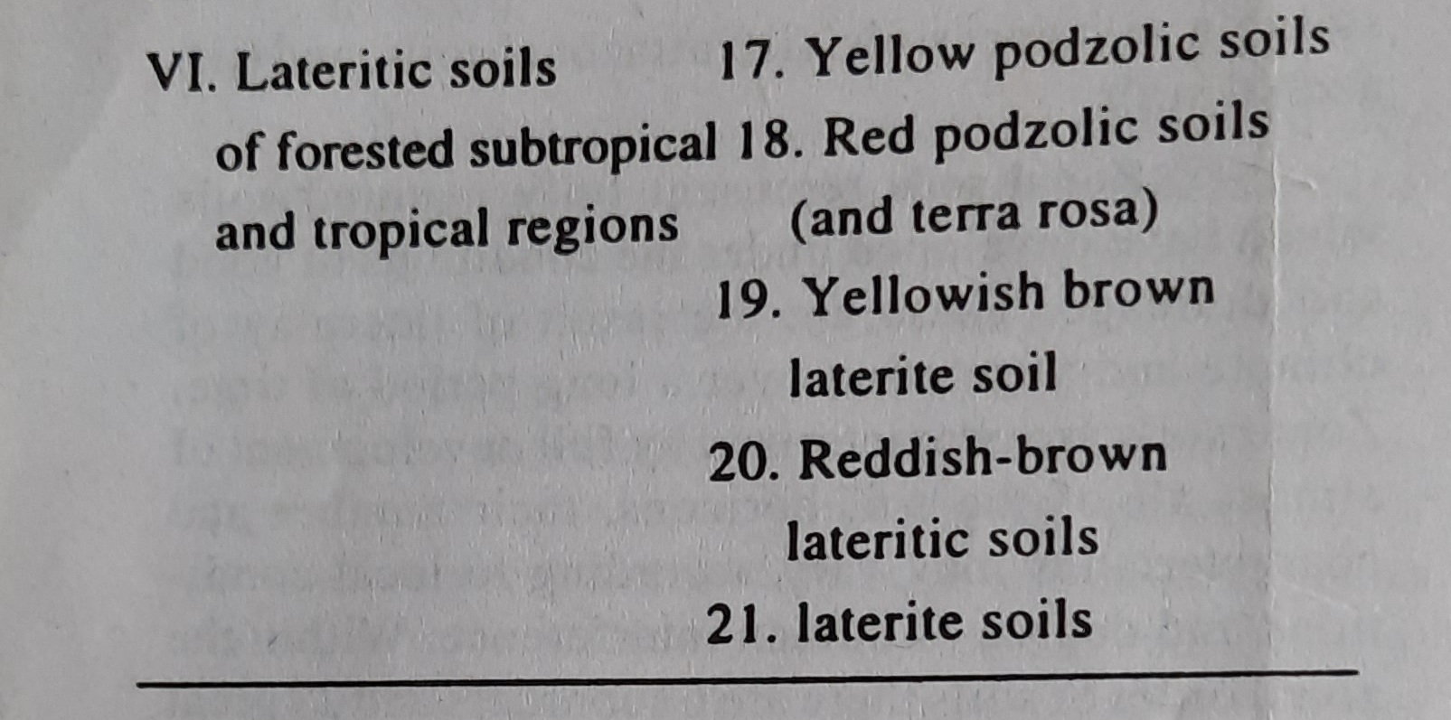

Slide 16
Intra-zonal Soils

Slide 18
Reference
1. Environmental Geography by Savindra Singh
2. https://byjus.com/biology/soil-profile/

