Slide 1
1st semester major & general

Slide 2
Basic Concept of Education
Education is simply to humanize
the human being.

Slide 6
Abbreviation of EDUCATION
E – Enlightenment
D- Development
U-United
C-Creativity
A-Accountability
T-Talent
I-Innovative
O-Outstanding
N-Nationality
Every day that use can actually teach interesting ordinary notion.

Slide 7
Meaning of Education
The word education comes from three Latin words. Educare, Educere ,Educatum.

Slide 8
Wider and Narrow Meanings
Wider meaning : Start from Cradle and ends to the Grave .
Narrow Meaning : Education is limited to some specific spheres.

Slide 9
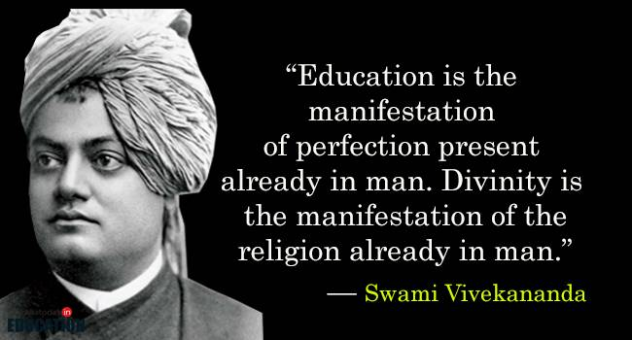

Slide 11
Definition of Education
Education is life long process to the adjustment with the changing society.
.Education is the dynamic side of Philosophy which seek to discover common and practical values of life and directs accordingly the natural development of the child.

Slide 12
Nature of Education
Education is a systematic process.
Education is a developmental process.
Education is modification of behaviour.
Education is a training.
Education is instruction and direction.
Education is a continuous process.
Education is a power and treasure.
Education is life.
Education is development of individual and society.

Slide 13
Importance of Education
We must not for a moment forget, it is a birthright to receive at least the basic education without which he/she can not fully discharge his/her duties as a citizen.

Slide 14
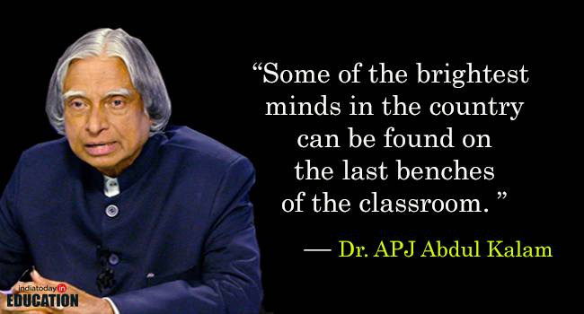
Importance of educational environment

Slide 15
Types of Education
Education is classified into three types :
Formal : School , College etc.
Informal :Education received by child through general environment.
Non-formal : Gained by agencies like scout , guide , extra-curricular activities…etc.

Slide 16
Aims of Education
Education is purposeful and ethical activity, hence it is unthinkable without aims.
Various views about the aims…..like the different views of educators ,thinkers and philosophers….that what should be the main aim of education.

Slide 17
Different Aims ofEducation
Individual Development aim
Social and citizenship aim
Vocational aims of education
The knowledge aim
The complete living aim.
Cultural Development aim
Character Development aim
Moral aim.
Self – realization.

Slide 18
Important factors of Education
Child
Teacher
Curriculum
Educational Environment

