Slide 1
IDEALIST THEORY OF THE STATE
PREPARED AND PRESENTED BY-
RUMA CHOWDHURY,
POST GRADUATE TEACHER,
DEPARTMENT OF POLITICAL SCIENCE,
WOMEN’S COLLEGE,AGARTALA

Slide 2
INTRODUCTION
Idealist theory is one of the most important philosophical theory regarding the nature of the state . Idealist theory vests absolute power in the state and regards state as an ethical institution.
The basic principle of this theory is that the state is an end and the individual is a means.According to Hegel ,the individual can perfect himself only in the state.Everything is neither within the state,nothing outside nor against it.

Slide 3
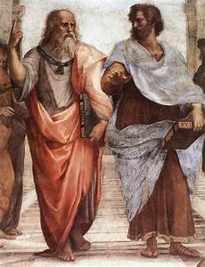
ORIGIN AND DEVELOPMENT OF IDEALIST THEORY OF STATE
Its earliest trace are found in the writings of Plato and Aristotle .Both of them regards state as natural and necessary element.
PLATO AND ARISTOTLE

Slide 4
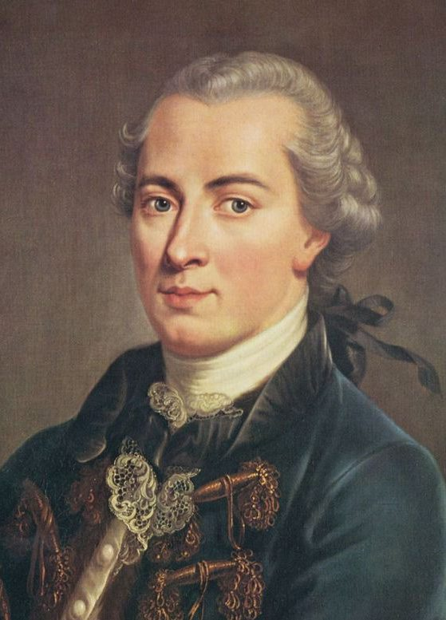
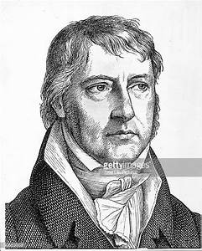
This theory was explained in better way by the German philosophers of the 18th and 19th centuries. In this connection we must remember two names ,Kant and Hegel . Other German philosophers like Neitsche , Bernherdi and Treitschke supported the extreme idealism of Hegel and glorified the state to an illogical extreme.
IMMANUEL KANT
G.W.F. HEGEL

Slide 5
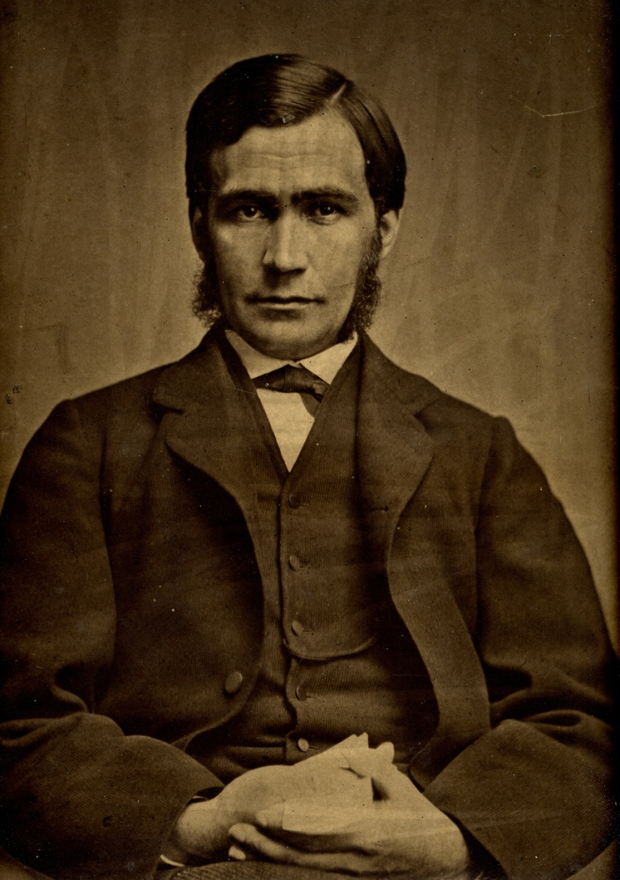
Green was an English philosopher and moderate idealist unlike the extremist like Hegel and Kant .Bradley and Bosanquet also advocated the cause of idealism almost in the same ways as T.H . Green.
T.H.GREEN

Slide 6
THE MAIN TENETS OF IDEALIST THEORY OF THE STATE
State is an ethical institution .
State is the Divine Idea as it exists on earth.
State has got its independent will and personality.
State is a natural, necessary and absolute association.
State possesses an organic unity.
State is the creator and protector of the rights and freedom of the individuals.
The basis of state is will, not force.

Slide 7
CRITICISM OF IDEALIST THEORY
An abstract theory .
Danger to the rights and freedom.
It is based on wrong conception.
Absolute conservative theory.

Slide 8
VALUE OF THE IDEALIST THEORY
The idealist theory is a happy blending of politics and ethics.
The theory is good because it emphasizes the need of cohesion between different individuals and also different associations.
The theory underlines the state is the source of all laws.
Lastly the theory keeps before it some ideal which may not exist in reality but must be path-finder for all states.

Slide 9
THANK YOU

