Slide 1
MEDIEVAL POLITICAL THOUGHT
Prepared and presented by-
Ruma Chowdhury,
Dept. of Political Science,
Women’s College,Agartala

Slide 2
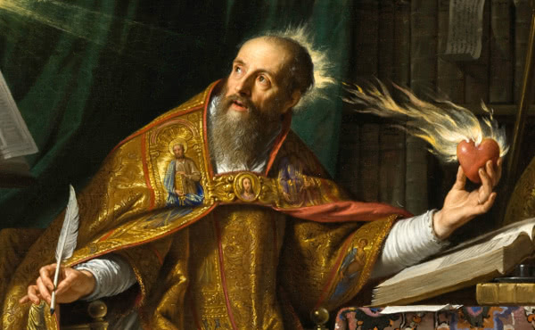
GREAT MEDIEVAL THINKERS
ST.AUGUSTINE
(354 A.D. – 430 A.D.)

Slide 3
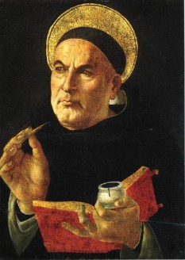
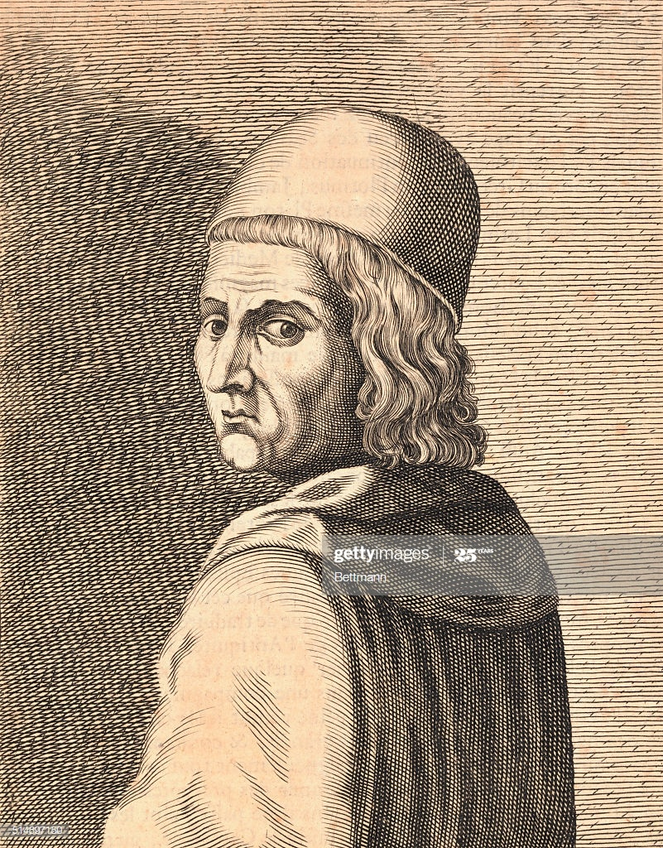
ST.THOMAS AQUINAS
1227 A.D. – 1274 A.D.
MARSILIUS OF PADUA
1270 A.D.- 1340 A.D.

Slide 4
FEATURES OF MEDIEVAL POLITICAL THOUGHT
The Medieval period was unpolitical.Niether political theory or ideology developed in the Middle Ages.
Universalism is the most important feature of medieval political thought.
In the Middle Ages, there was no organized state , not even in state in any loose sense.
In the Medieval Period politics , economics, religion all were mingled together.

Slide 5
Parallelism between Platonism and Medievalism.
Doctrine of two swords.
Emergence of feudalism.
Medieval Political thought is the predominance of the law of nature.
The political thought in the Middle Ages was unhistorical ,unscientific and uncritical.

Slide 6
THANK YOU

