Slide 1
NSRPTA (8th -9th February 2020) National Seminar on Role of Physics in Technological Advances & 37th Convention of Orissa Physical Society
Title of the Paper:
Effect of various parameters on J-aggregates of an Azo Dye Chromotrope–2R in LbL film: A Spectroscopic Investigation
Presented by:
Dr. Subrata Deb
Assistant Professor
Department of Physics
Women’s College, Agartala-799 001, Tripura, India

Slide 2
Outline:
Introduction
Applications of Thin Films
Various methods of Thin Film Deposition
The Layer by Layer technique
Advantages of LbL Technique
Formation of LbL films
Spectroscopic Characterization
Conclusion
Acknowledgments
References

Slide 3
Introduction
Thin films of thickness of few nanometers (monolayer/multilayer) are the source of high expectations as being useful components in many practical and commercial applications such as sensors, detectors, Organic optoelectronics devices, Molecular electronics devices.

Slide 4
Application Area of Thin Films:
Operational amplifiers (OP-AMP)
Field effect transistors (FET)
Metal Oxide semiconductor field effect transistor (MOSFET)
Various optoelectronic devices
Optical Signal processing
Semiconductor chips
Optical switching devices
Models Mimicking biological membranes
Optical recording
Optical interference filter
Optical Image sensors
Alignment of layers of liquid crystal
Sensors
Detectors & displays etc.

Slide 5
Various methods of Thin Film Deposition
Thermal Evaporation
Solvent casting
Plasma polymerization
Spin Coating
Dip Coating
Sputtering
Electro deposition
Molecular beam Epitaxy (MBE)
Adsorption from Solution
Langmuir-Blodgett (LB) technique
Layer-by-Layer self assembly
Lithography etc.

Slide 6
Layer by Layer (LbL) Technique:
LbL approach is based on the alternate deposition of different biopolymers and allows an effective control over the physicochemical properties and activity of edible coatings.
LbL self-assembly, also known electrostatic self-assembly.
This ionic self-assembled technique, introduced by Decher in 1991 (G. Decher et. Al. 1991) provides an elegant way of controlling the composition of the resulting assemblies.
LbL assembly is a cyclic process in which a charged material is adsorbed onto a substrate and after washing, an oppositely charged material is adsorbed on top of the first layer.
Thickness of a single bi layer is generally of the order of nanometer and deposition process can be repeated to obtain multilayer films.

Slide 7
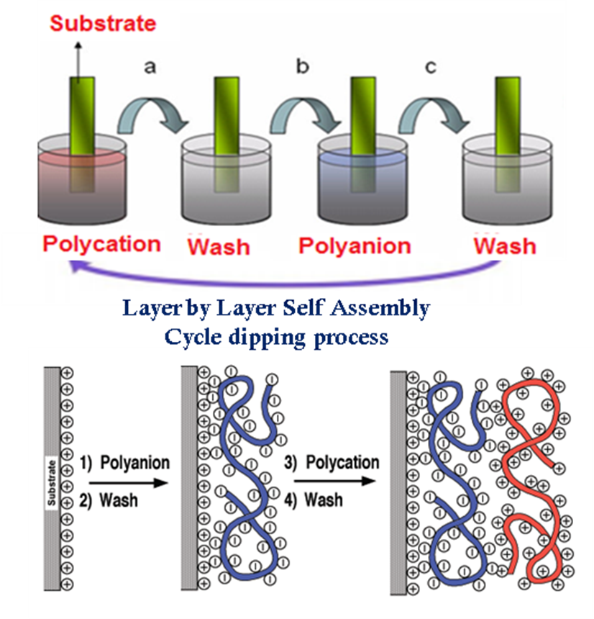
Layer by Layer (LbL) Technique:
A clean quartz slide is dipped into solution of polycation/polyanion.
The slide is dried completely and then rinsed into a water bath to remove excessive ions.
Then the film is dried and is dipped into a solution of negatively/positively charged molecules.
The film is again washed and dried and we get a 1-bilayer LbL film.
The procedure is repeated to obtain multilayers.

Slide 8
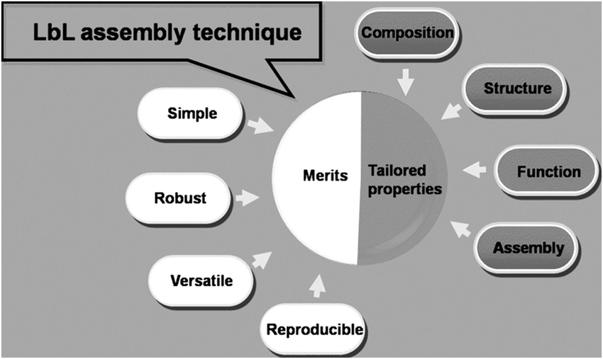
Advantages of LbL self-assembly:

Slide 9
Sample used 1. Anionic azo dye Chromotrope 2R 2. Cationic polymer Poly (diallyldimethylammonium Chloride)
Formation of LbL film:

Slide 10
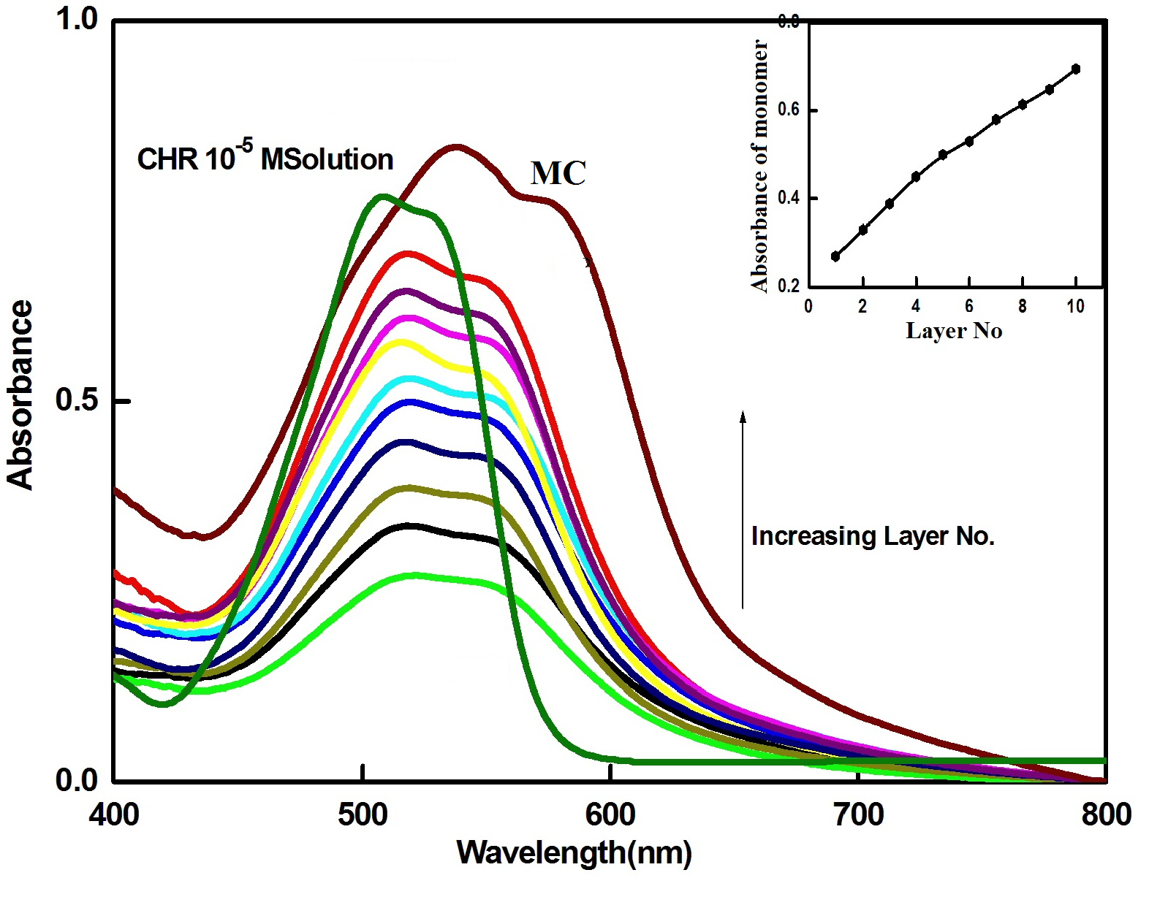
Variation of Thickness of LbL Films:
Fig. 1 shows the normalized UV-Vis absorption spectra of LBL films of PDDA-CHR (1-10 bilayers) alongwith solution and microcrystal absorption spectrum.
The solution absorption spectrum of CHR (concentration 10⁻⁵ M) possesses a band spectrum in the region 400–600nm with a high energy monomeric band at 506 nm alongwith another dimeric band (J-aggregate band) at 532 nm which is consistent with the reported results.
In case CHR microcrystal absorption spectrum, the monomeric band gets shifted towards longer wavelength region to about 537 nm and dimeric band at around 576 nm. This may be due to the change in micro environment induced in the micro crystal film.

Slide 11
Variation of Thickness of LbL Films:
The absorption spectra of all the LBL films (1-10 bilayers) are almost identical as far as their band profile is concerned with only modification in the fact that in these cases, both monomeric and dimeric bands get broadened and red shifted towards 517 nm and 552 nm respectively. In addition to this red shift, there is also an enhancement in the intensity of both the bands with increasing the layer thickness. The inset of fig. 1 also showing the variation of intensity of both monomer and dimer indicates the same. With increasing layer thickness, more CHR molecules occupy electrostatically with PDDA molecules on the substrate and hence there will be an enhancement in the intensity of both the bands.

Slide 12
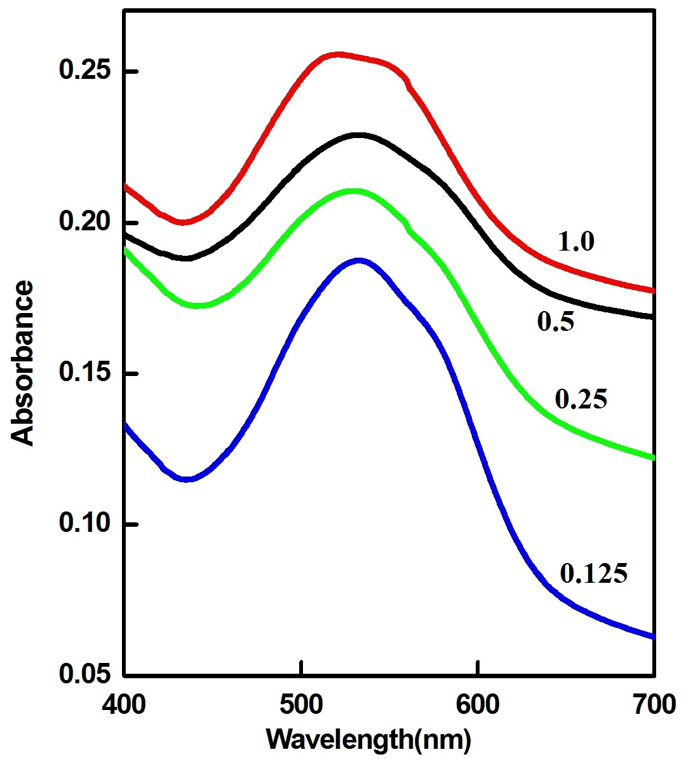
Effect of Ionic Strength
Figures 2 shows the UV-Visible absorption spectra of PDDA-CHR stable LBL films fabricated by varying the ionic strengths viz. at four ionic strengths 0.125, 0.25, 0.50 and 1.0. It is clear that the J-band intensity at 552 nm increases with increase in ionic strength. Deconvolution of the corresponding absorption spectra also supports the same (figure not shown).

Slide 13
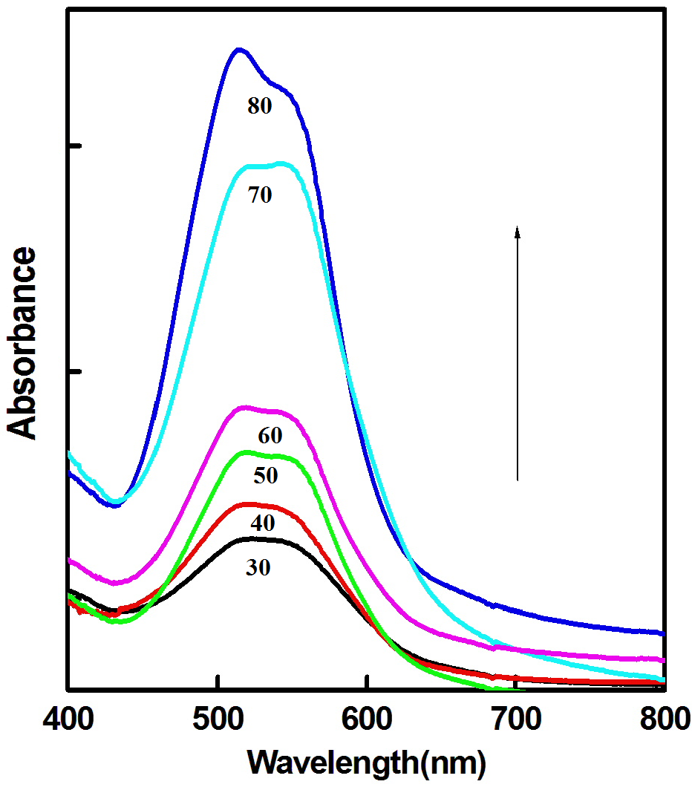
Effect of temperature
Figure 3 shows the variation of CHR absorbance with increase in temperature. It is clear from the figure that the J-band intensity increases with increase in temperature up to 70⁰C. This also confirmed from the Deconvolution of the corresponding absorption spectra (figure not shown). This may be due to the slight reorientation of CHR molecule due to increase in temperature. Further increase in temperature shows the decrease of J-band intensity. This may be due to the dissociation of aggregated molecules on ultrathin film. Disorder ness increases with increase in temperature of the system and hence molecular orientation changes. At higher temperature in this case dissociation of J-aggregate occurs and thereby increases the non-radiative transition rate, which results in decrease in J-aggregated band intensity. It has been reported that upon heating merocyanine J-aggregate in LB film dissociated with simultaneous increase in monomer band.

Slide 14
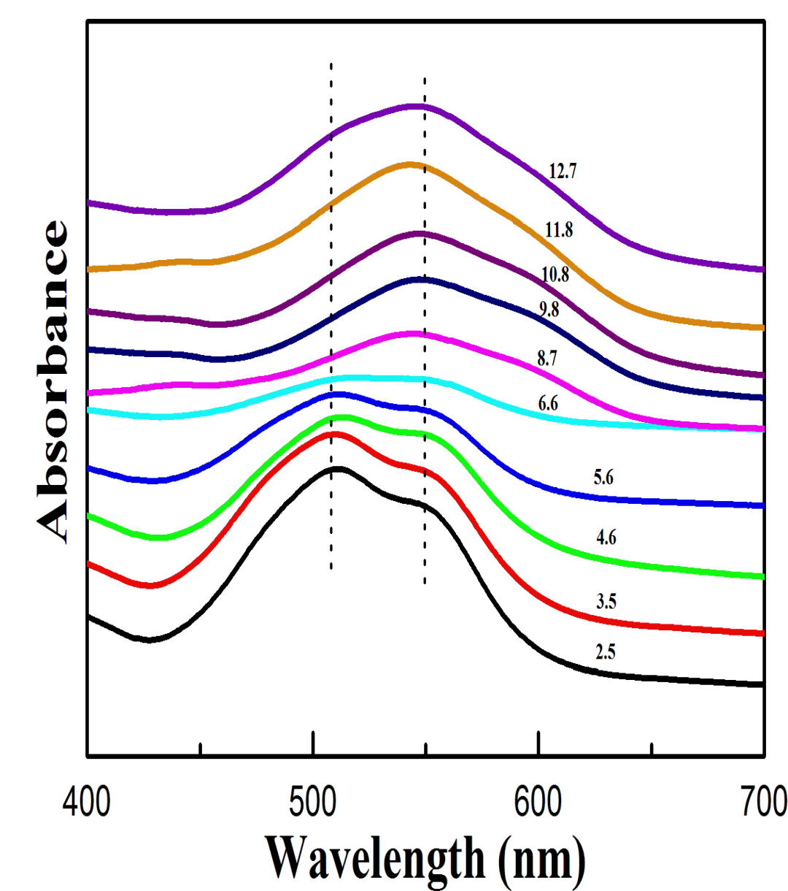
Effect of pH
Figures 4 shows the UV-Visible absorption spectra of PDDA-CHR LBL films at different pH conditions. Here, the pH of the solution is varied from 2.5 to 12.7 in both cases.
Some worth noting observations are observed in this study.
From figure 4, it is observed that the intensity of monomeric bands at 517 nm was prominent with a weak dimeric band at 552 nm at lower pH with slight shifting, which may be due to the reorientation of the molecules in the solution.
However, at pH≥6.6, the J-aggregate band at 552 nm becomes prominent. This reveals that there is a modification in the nature of interaction when the solution changes from acidic to basic one.

Slide 15
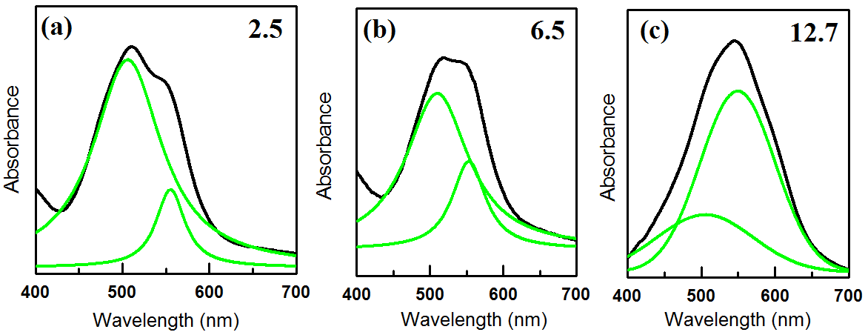
Effect of pH
Deconvolution of the absorption spectra at different pH was calculated using Origin 6.0. Deconvolution of the absorption spectra at pH 2.5 shows two Gaussian curves corresponding to monomer at 517 nm and J-aggregate at 552 nm (figure 5). From figure 5, it is clear that the monomer intensity decreases with increase in pH but interestingly the J-band intensity increases with increase in pH and becomes prominent at 12.7 pH which supports our spectroscopic study.

Slide 16
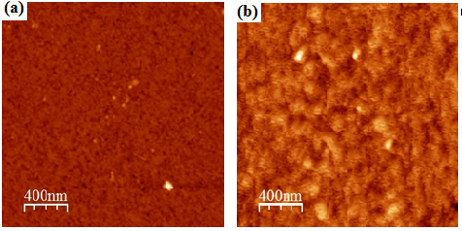
AFM Study
To have some visual information about the surface morphology of as prepared LBL film, we have studied AFM imaging at lower (2.5 pH) and higher (12.7 pH) pH value. Our spectroscopic study reveals that at lower ph, CHR shows prominent monomer band but at higher ph CHR J-aggregate formed in the LBL film. From the AFM figure 6a and 6b, it is clear that the morphology changes when we increased the ph value. Figure 6a show uniform surface through out the film but figure 6b shows some circular shaped domains which may be due to the formation of CHR J-aggregate in the LBL film

Slide 17
Conclusion
The photophysical properties of PDDA-CHR in LBL film have been investigated.
Layer study shows that the absorbance increases almost linearly with increasing the number of layers deposition, and thereby suggesting the regularity and highly reproducible characteristics from layer to layer.
Temperature study reveals that the CHR film is very stable with increase in temperature as well as J-aggregate increases with increase in temperature upto a certain value 70⁰C.
Ionic nature also increases the J-aggregation of CHR in LBL film.
However pH study is quite different, it shows less J-aggregation for lower pH value but CHR J-aggregation enhanced when we increase the pH value.

