Slide 1
ASIAN WATERBIRD CENSUS 02.01.2023-05.01.2023 LOCALLY EXECUTED BY TRIPURA BIODIVERSITY BOARD
Coordinated by
Dr. Krishnendu Das
Department of Mathematics, Women’s College, Agartala

Slide 2
What are waterbirds?
Waterbirds have been defined as “species of bird that are ecologically dependent on wetlands”. This is the definition used by the Ramsar Convention on Wetlands. For the purposes of the International Waterbird Census, all species in the following families are considered by Wetlands International to be waterbirds:
1. Gaviidae (Divers/Loons)
2. Podicipedidae (Grebes)
3. Pelecanidae (Pelicans)
4. Phalacrocoracidae (Cormorants)
5. Anhingidae (Darters)
6. Ardeidae (Herons)
7. Scopidae (Hamerkop)
8. Ciconiidae (Storks)
9. Balaenicipitidae (Shoebill)
10. Threskiornithidae (Ibises and Spoonbills)
11. Phoenicopteridae (Flamingos)
12. Anhimidae (Screamers)
13. Anatidae (Ducks, Geese and Swans)

Slide 3
14. Gruidae (Cranes)
15. Aramidae (Limpkin)
16. Rallidae (Rails, Gallinules and Coots)
17. Heliornithidae (Finfoots),
18. Eurypygidae (Sunbittern)
19. Jacanidae (Jacanas)
20. Rostratulidae (Painted Snipes)
21. Dromadidae (Crab Plover)
22. Haematopodidae (Oystercatchers)
23. Ibidorhynchidae (Ibisbill)
24. Recurvirostridae (Stilts and Avocets)
25. Burhinidae (Thick-knees)
26. Glareolidae (Coursers and Pratincoles)
27. Charadriidae (Plovers)
28. Scolopacidae (Sandpipers, Snipes and Phalaropes)
29. Pedionomidae (Plains Wanderer)
30. Thinocoridae (Seedsnipes)
31. Laridae (Gulls)
32. Sternidae (Terns)
33. Rynchopidae (Skimmers)

Slide 4
BENEFITS OF CONSIDERING ENTIRE FAMILIES AGAINST INDIVIDUAL SPECIES
Only a few wetland birds are excluded by considering entire families in this way. Conversely, the inclusion of whole families results in the waterbird list containing a few non-wetland species such as some coursers and thick-knees. These rather minor anomalies are thought to be outweighed by the convenience of a whole-family approach to the definition of the term ‘waterbird’ and, in particular, considering the complications that would arise from applying the definition rigidly to every species.
The Ramsar Convention on Wetlands has widened its approach to include more families traditionally regarded as seabirds, as well as certain raptors and passerines. In 2008, the African-Eurasian Migratory Waterbird Agreement and later the East Asian – Australasian Flyway Partnership have also included some migratory seabirds. Hence, it is possible that a small number of additions will be made in the coming years to the families and species included in waterbird counting programmes.

Slide 5
WHY COUNT WATERBIRDS?
Long-term monitoring of waterbirds by continental-scale censuses provide crucial information which underpins the conservation of waterbirds and their wetland habitats. The rationale behind waterbird monitoring was summarised eloquently by Matthews (1967) at the time when international coordination of waterbird counting was beginning
Waterbirds are well-known indicators of the quality of certain types of wetlands. A powerful tool which makes use of this characteristic is the so-called 1% criterion, whereby any site which regularly holds 1% or more of a waterbird population qualifies as a wetland of international importance under the Ramsar Convention on Wetlands. The 1% criterion has been adopted by the European Union to identify Special Protection Areas (SPAs) under the Birds Directive. It is also used by BirdLife International in the identification of Important Bird Areas (IBAs) in wetlands throughout the world.

Slide 6
WHY COUNT WATERBIRDS? ctd…
Studying waterbirds also give important information regarding global warming and climate change viz studying of nesting habits of Arctic birds and the change in their nesting patterns because of changes in melting of glaciers give important information about changing temperatures.
Changes in numbers of birds can also indicate a decline is supporting conditions of the waterbody
Sudden change in numbers of waterbirds indicate human induced changes and a gradual decline indicates long term usage patterns which are not sustainable in general or is in direct conflict with some/many species of birds using the wetland/lake/waterbody.

Slide 7
What is the International Waterbird Census? What is Asian Waterbird Census?
The International Waterbird Census (IWC) is a site-based counting scheme for monitoring waterbird numbers, organised since 1967 by Wetlands International, formerly the International Waterfowl and Wetlands Research Bureau (IWRB). The Census operates at a global level, and the former division into four separate continental-scale surveys was superseded in 2003 by a new strategy for global coordination. Coordination at continental level takes place as follows:
Global coordination, and the counts in the Western Palearctic and southwest Asia are organised from Wetlands International Global Office in Ede, The Netherlands
The African Waterbird Census is coordinated from an office in Dakar, Senegal
The Asian Waterbird Census, which includes Oceania, is coordinated from an office in Delhi, India (Hence it is a part of IWC)
In the Americas, the Neotropical Waterbird Census is coordinated from the Americas office of Wetlands International in Buenos Aires, Argentina

Slide 8
The aims of the census :
To monitor the numerical size of waterbird populations;
To describe changes in numbers and distribution of these populations;
To identify wetlands of international importance for waterbirds at all seasons;
To provide information to assist protection and management of waterbird populations through international conventions, national legislation and other means.

Slide 9
Where to count waterbirds?
Sl. No. | Name of the site | District | Experts | Date of count | Mobile
1 | M.B.B. College lake | West Tripura | Mr. Sajib Das | 04/05.02.2023 | 7005012070
2 | NIT Campus waterbody | West Tripura | Dr. Krishnendu Das | 04/05.02.2023 | 9862087749
3 | Amritsagar, Obosarika | Sepahijala | Dr. Krishnendu Das | 02/03.02.2023 | 9862087749
4 | Rudrasagar | Sepahijala | Mr. Priyabrata Debnath | 02/03.02.2023 | 9362121621
5 | Sukhsagar | Gomati | Mr. Diptanu Debnath | 03/05.02.2023 | 9383253275
6 | Trishna WLS lakes | South Tripura | Mr. Sanjib Das, IFS Mr. Diptanu Debnath | 04.02.2023 | 7630049150 9383253275
7 | Dumboor reservoir | Dhalai | Mr. Pinak Paul Mr. Priyabrata Debnath Mr. Aniket Roy | 04/05.02.2023 | 8787366206 9362121621 6909980472
8 | Sattar Mia Haor | Unakoti | Mr. Nihar Chandra Deb | 05.02.2023 | 8257817374
9 | Khawrabil | Unakoti | Mr. Chayan Debnath | 05.02.2023 | 7005874071

Slide 10
How to count waterbirds
With the exception of Dumboor reservoir every other site mentioned above will follow same method. Each site will be covered by a single team and the team will take checklists in eBird with a minimum duration of 30 minutes counting all species that they are able to see or hear. It is sugested to take as many photos and sound recordings, videos as possible.
Except the sites in Unakoti all other sites are pretty well known and well documented too by one or more of the experts mentioned. Dumboor has also been studied but less compared to the others. In fact expectations to record rare birds is highest from Dumboor specially ducks, geese, grebes etc
The method for Dumboor will be similar but will require coordination from teams and the approaches have to be selected properly to cover the most promising parts in terms of bird availability. However it must be remembered that rare birds may turn up even where they are least expected.
Weather conditions, time human interference and other general information related to the waterbody are to be recorded for the visit day.

Slide 11
COUNTING TECHNIQUES, EQUIPMENT NEEDED ETC
Any experienced birdwatcher can count waterbirds, and a count on foot of a small to medium sized site is quite a straightforward undertaking. The methods used to count waterbirds in the field depend on many factors, for example:
The species being monitored; •
The size of the site
The accessibility of the shoreline
The availability of vantage points from which the site can be scanned;
The amount of time available to complete the count;
The number of people involved;
The available equipment.
The top priority is however proper identification of birds , a fairly exact count of each species and adoption of same method by all teams.
Equipments: Binoculars, Camera preferably with a zoom lens of minimum 300 mm ( 500 mm preferred), mobile with merlin and ebird installed.

Slide 12
Different Methods employed in counting birds
Ground counts
These are the simplest and most common form of census under IWC. The term refers to a count made from the ground (as opposed to an aircraft or boat), usually on foot, although bicycles, cars or other vehicles might be involved. The site is covered systematically, usually by walking the same route on each visit and stopping every few hundred metres to scan with binoculars and/or a telescope to count the birds. When choosing a route (which is best done using a map in the first instance), thought should be given to light conditions (birds are easier to see with the light behind you), and to the risk of disturbing flocks of birds by your presence.
It is important to use the best vantage points, and to divide the site up into areas that are visible from the chosen vantage points without overlap of areas counted and without missing any part of the site. Counts are made by scanning flocks of waterbirds (which usually comprise several species) with a telescope or with binoculars as appropriate, and counting each species one-by-one, or in “blocks” of bigger numbers

Slide 13
Boat survey
At many sites, especially large, remote ones, boat surveys may be the best way to count the waterbirds. Identifying and counting birds from a boat may, however, be difficult. Boats can cover large distances and give access to areas which would otherwise not be covered. They may also cause less disturbance than would be caused by surveyors on foot, although the opposite can also be true. At extensive and remote sites, for example lakes, rivers or coastal areas fringed with vegetation, or mangrove complexes, there may be no practical alternative to boat survey. Some of the difficulties with boat surveys include the low vantage point offered by small boats, the fact that they are unstable viewing platforms, often preventing the use of a telescope, and the fact that they are slow moving, so that any birds disturbed by the boat may be counted more than once. Boats also cannot be used in adverse weather or tidal conditions. They are, however, widely available for hire in many wetland areas, and much less expensive than aircraft.
Two other methods are Aerial surveys and Expeditions but we skip these as they are not applicable in our case

Slide 14
How to count in “blocks”
Experienced counters can accurately estimate 10, 20, 50, 100 or more birds almost instantaneously, and scan through flocks counting in these “blocks”. It is preferable to estimate in small units (10 is probably the most commonly used block). Tally counters can save time and increase the accuracy of counts. The tally counter can be used to count one-by-one, or, each click of the button on the tally counter can be used to represent a “block” of birds. Blocks of 100 or more are generally only used for birds in flight where time is very limited. The first block may be counted one by one, and the mental image of this first block can then be used to assess the number of blocks in the flock containing the same number of birds. Some experienced observers use two tally counters to count two species at a time, but this takes practice and can reduce the accuracy of counts. Birds should be counted one at a time, as at small sites, if there is no shortage of time. It is usually preferable, however, to count faster than this to prevent problems caused by birds moving about in response to the tidal cycle or to disturbance. A tally counter can be useful in these circumstances . It is easiest to count birds in feeding or loafing congregations on the ground or water. If counts of birds in flight are necessary, flocks in flight are often best counted from the back of the flock, scanning in the direction of flight with binoculars or a telescope. Large flocks introduce an inherent bias; small sites with few birds can be counted with greater accuracy than large sites with many birds.

Slide 15
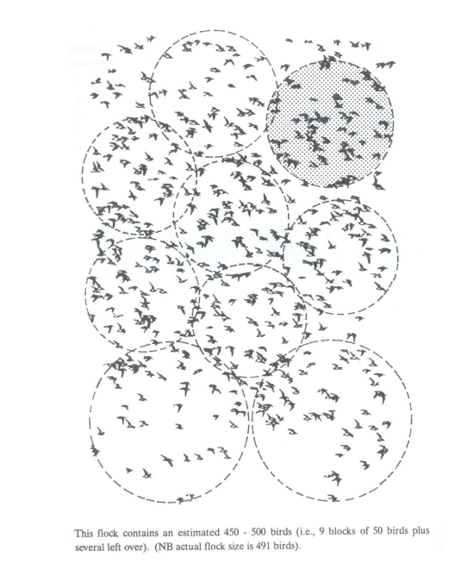

Slide 16
The importance of recording zero counts
If a site is visited and no birds are present because of drought, freezing or disturbance, for example, it is important to record a zero count and send it to the national coordinator at the same time as the rest of the year’s counts. If the counter is certain the site is dry or frozen, a nil return can be sent to the National Coordinator without visiting it. Failure to submit nil returns will result in incorrect calculation of average counts for the site, and incorrect treatment of the site for population trend analyses (the trend analysis programme will assume that the site has not been counted and will impute missing values for the species usually counted at the site). If a site is destroyed and counts stop for this reason, it is similarly important to inform national coordinators of waterbird monitoring programmes.

Slide 17
Some checklists taken from different waterbodies in Tripura
https://ebird.org/checklist/S123046977
https://ebird.org/checklist/S123046858
https://ebird.org/india/checklist/S122967044
https://ebird.org/checklist/S123046971
https://ebird.org/checklist/S122699817
https://ebird.org/checklist/S122445624
https://ebird.org/checklist/S120752807
https://ebird.org/checklist/S122335833
https://ebird.org/checklist/S120752807
https://ebird.org/checklist/S119372804
https://ebird.org/checklist/S118504713
https://ebird.org/checklist/S126263998

Slide 18
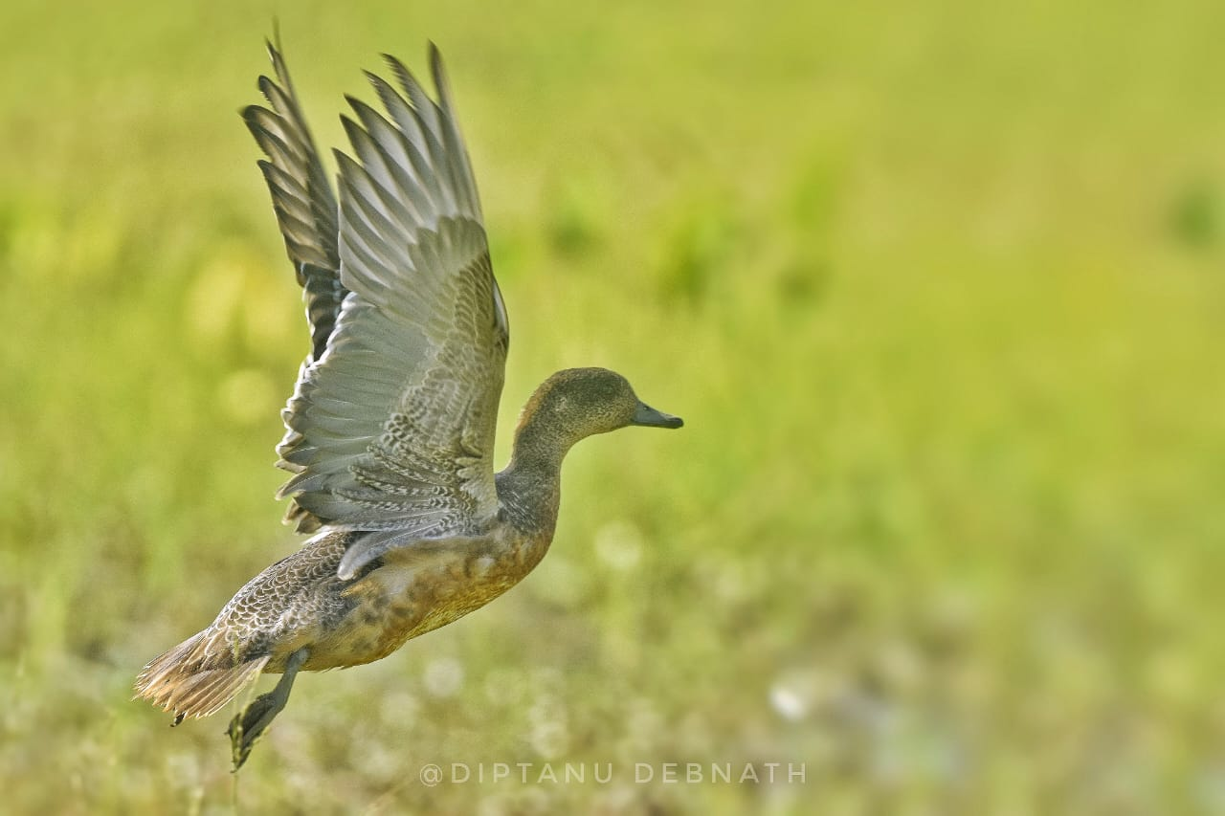
Some photographs taken by expert birders and photographers
Eurasian Wigeon, Location: Sukhsagar, Udaipur
Photographed by: Diptanu Debnath

Slide 19
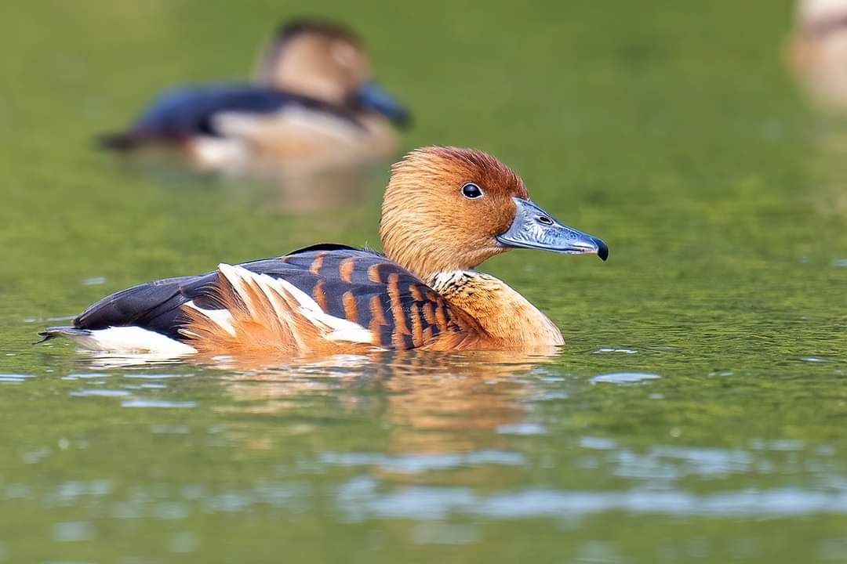
Fulvous whistling duck. Location: MBB College lake
Photographed by: P.S. Chakraborti

Slide 20
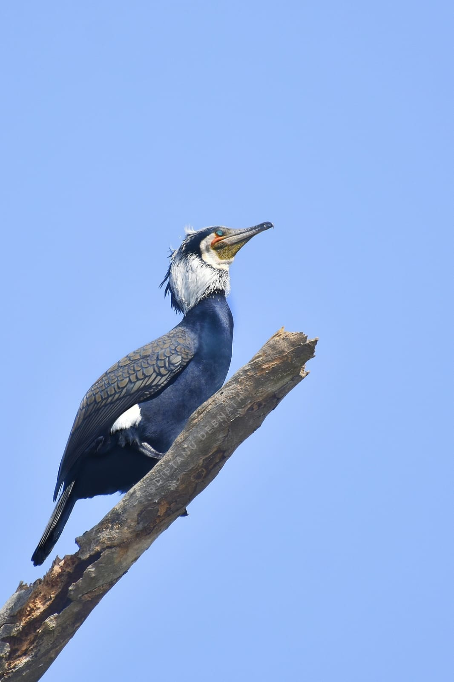
Great Cormorant, Location : Udaipur
Photographed by: Diptanu Debnath

Slide 21
Great crested grebe Location: Dumboor reservoir
Photographed by: Priyabrata Debnath

Slide 22
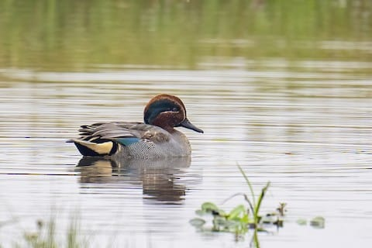
Green winged teal,
Location: Sukhsagar, Udaipur
Photographed by: P.S. Chakraborti

Slide 23
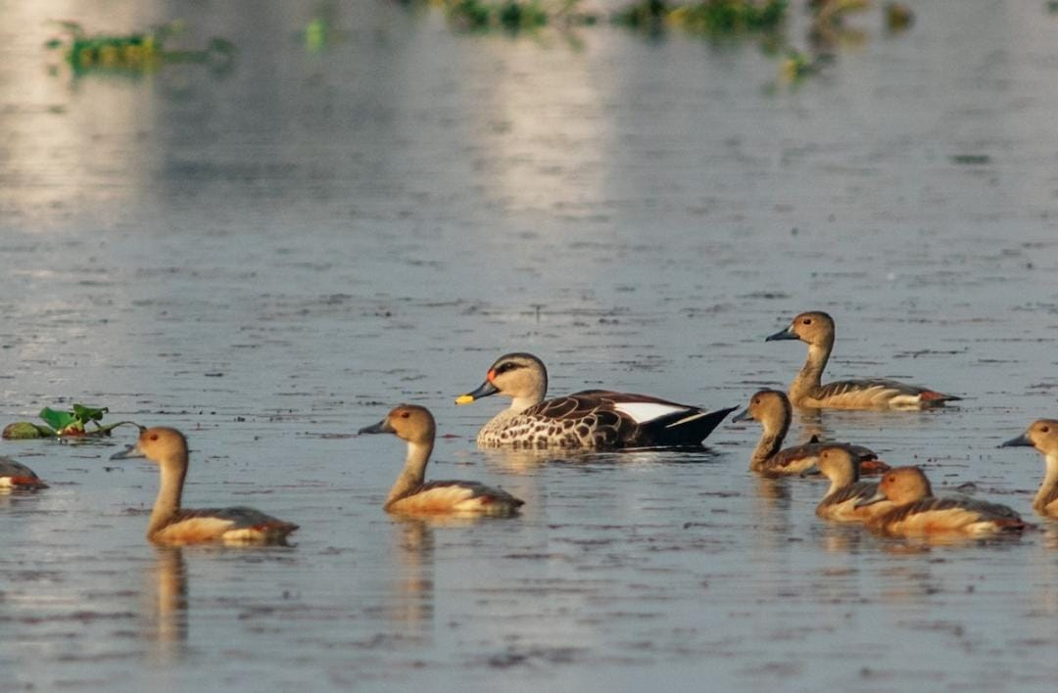
Indian Spotbill duck, Location: Rudrasagar
Photographed by: Dipankar Deb

Slide 24
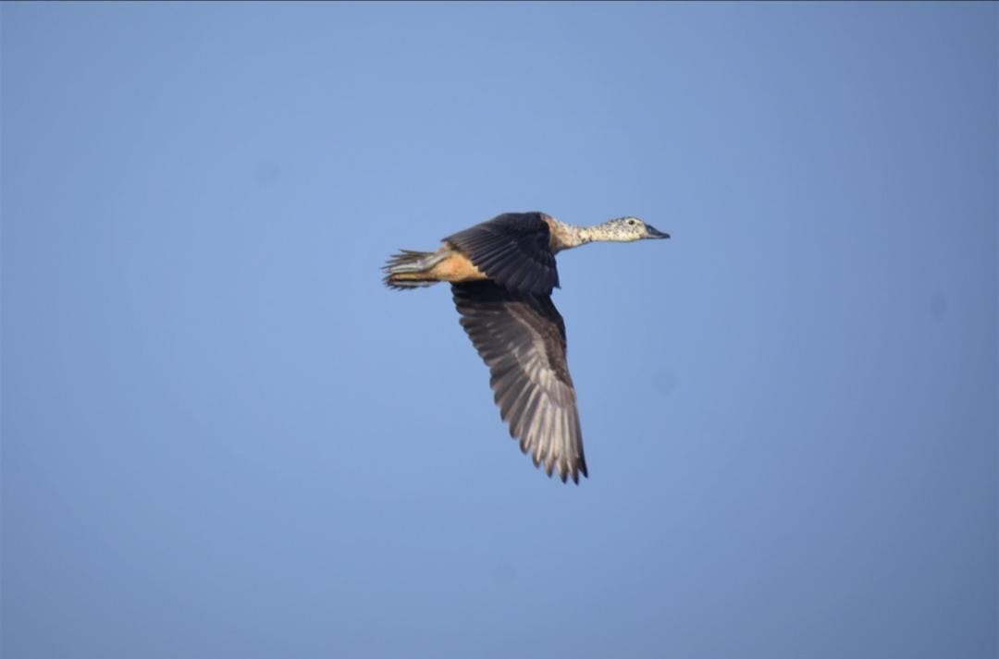
Knob billed duck, Location: Sukhsagar, Udaipur
Photographed by: Diptanu Debnath

Slide 25
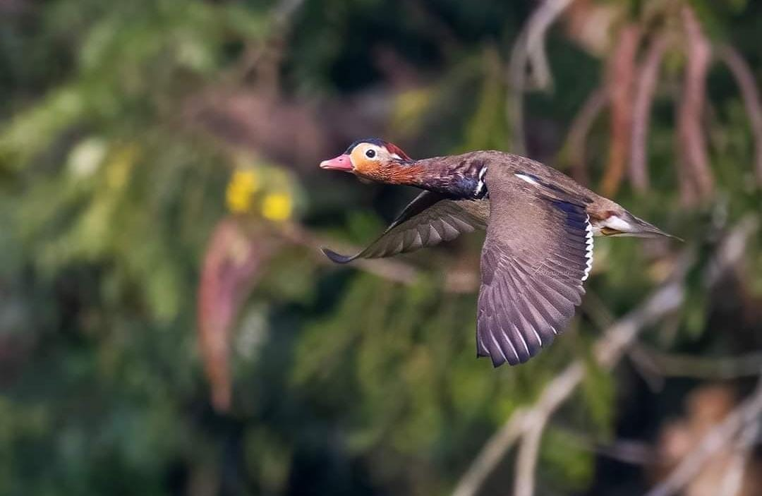
Mandarin Duck, Location: Trishna WLS
Photographed by: P.S. Chakraborti

Slide 26
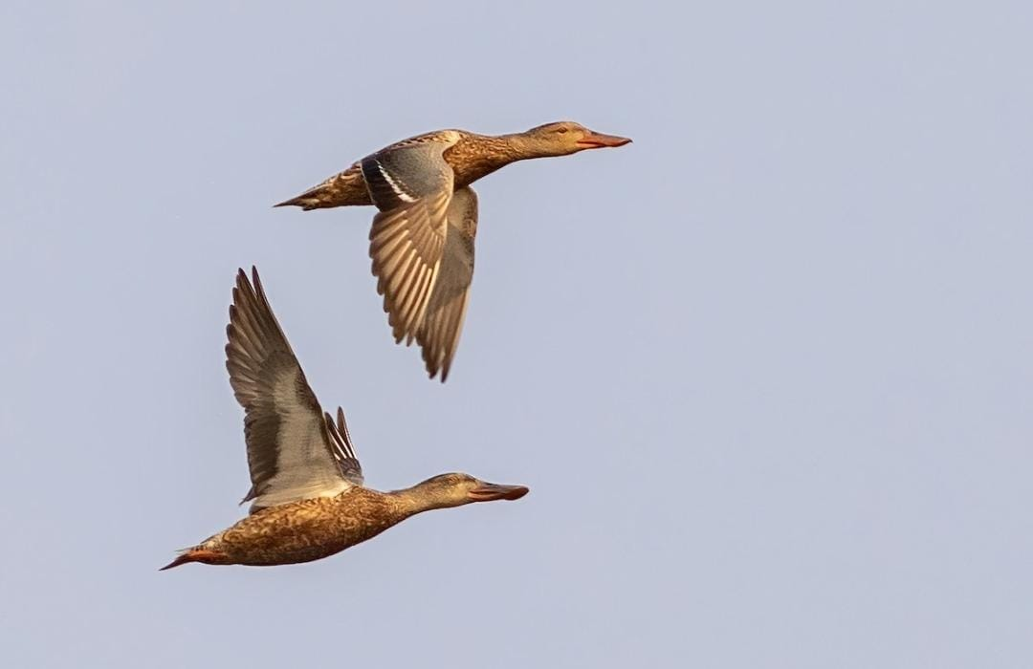
Northern Shoveler, Location: Rudrasagar
Photographed by: Dipankar Deb

Slide 27
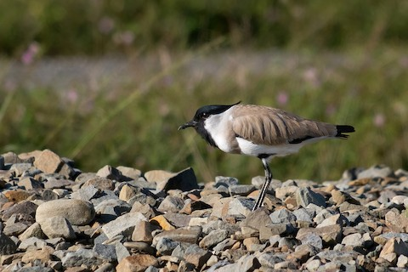
River Lapwing, Locatioin: Sukhsagar, Udaipur
Photographed by: Dipankar Deb

Slide 28
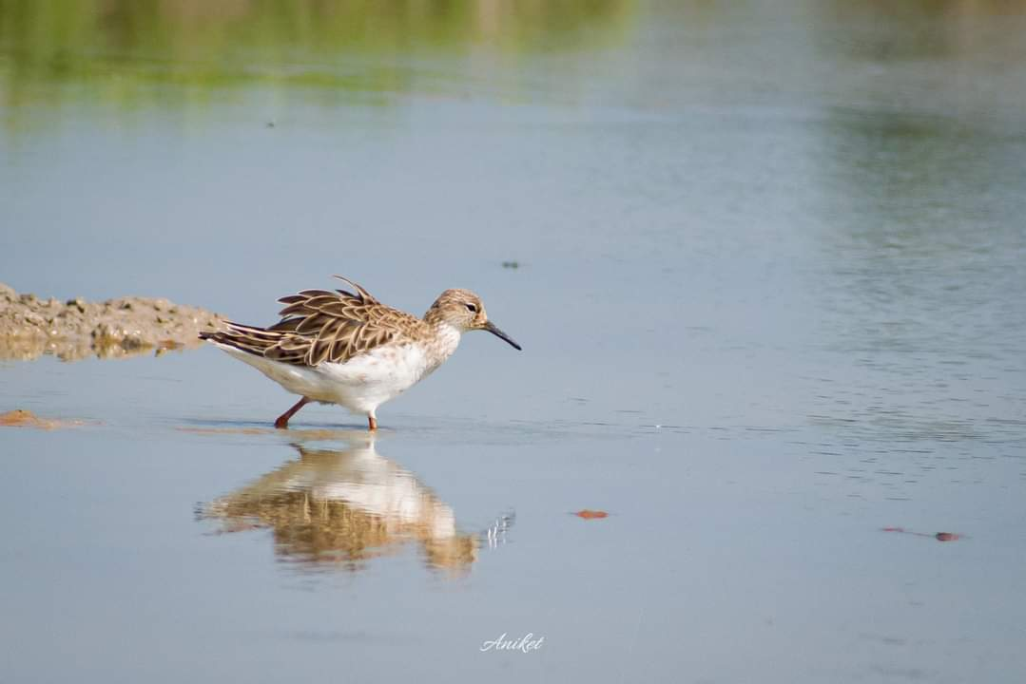
Ruff, Location: Sukhsagar,Udaipur
Photographed by Aniket Roy

Slide 29
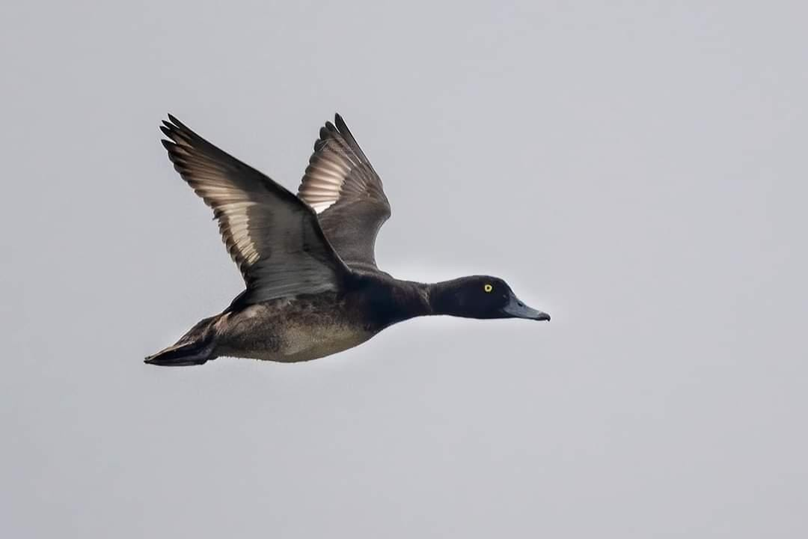
Tufted duck, Location: Rudrasagar
Photographed by: P.S. Chakraborti

Slide 30
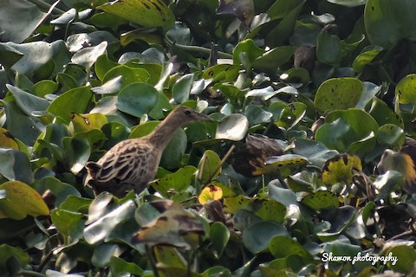
Watercock , Location:
Photographed by: Shaon Kuri

Slide 31
Acknowledgements
The following persons have been immensely helpful for permission to participate in the programme, preparation of this presentation and beyond.
Dr. Manidipa Debbarma, Principal, Women’s College
Mr. Probal Chowdhury, Dept. of Botany, Women’s College
Dr. Doyal Debnath, Dept. of Mathematics, Women’s College
Dr. Dipak Sinha, CAT, Lembucherra
Mr. P.S. Chakraborti, Mr Shaon Kuri, Mr. Aniket Roy, Mr Diptanu Debnath, Mr, Dipankar Deb, Mr. Priyabrata Debnath, Mr. Pinak Paul for allowing to use their photographs and checklists generously
Mr. Aniket Roy, Mr. Diptanu Debnath, Mr. Priyabrata Debnath, Mr. Pinak Paul, Mr. Sajib Das, Mr. Sanjib Das, Mr Chayan Debnath, Mr. Nihar Ch. Deb for agreeing to be present at different sites during the counts.
Tripura Biodiversity Board for placing their faith in me and the presentation has been tailored from the guidelines of Birdcountindia.
I express my heartfelt thanks to all here and beyond for supporting me in this endeavour and express sincere apologies for missing out any names that deserved a mention.

Slide 32
Thank You

