Slide 1
B.A.HISTORY(HONS) 1ST YEAR(SEMESTER 1)
UNIT-2
EMERGENCE OF EARLY HISTORIC INDIA

Slide 2
Iranian and Macedonian invasions –causes and impacts
Iranian Invasion of India
The Iranians invaded India in the 6th century B.C, when King Darius I ruled over Iran.
He invaded India and occupied the territories in the North-Western Frontier Province, Sind and Punjab in 516 B.C.
These parts remained with the Iranian Empire till Alexander’s invasion of India.
The Condition in India, at that time
In north-east India, smaller principalities and republics gradually merged with the Magadhan Empire.
North-west India, however, presented a different picture in the sixth century BC. Several small principalities, such as those of the Kambojas, Gandharas, and Madras fought one another.
This area did not have any powerful kingdom like that of Magadha to weld the warring communities into one organized kingdom.
Further, as the area was fertile and rich in natural resources, it attracted the attention of its neighbours. In addition, it could be easily penetrated through the passes in the Hindu Kush.

Slide 3
THE INVASION
The Achaemenian rulers of Iran, who expanded their empire at the same time as the Magadhan princes, took advantage of the political disunity on the north-west frontier.
The Iranian ruler Darius penetrated north-west India in 516 BC and annexed the Punjab, west of the Indus, and Sindh.
This area was converted into the twentieth province or Satrapy of Iran, which had a total number of twenty-eight satrapies.
The ‘’Indian satrapy’’ included Sindh, the north-west frontier, and the part of Punjab that lay to the west of the Indus.
Further, the Indian subjects were also enrolled in the Iranian army.
Xerxes, Darius’s successor, employed Indians in the long war against the Greeks. It appears that India continued to be a part of the Iranian empire till its invasion by Alexander

Slide 4
Impact of the Invasion on India
Political impact
Even though the invasion did not affect Indian Politics in any significant manner, it only exposed the weakness of the Indian Defense in that region and paved way for the conquest of Alexander.
The Satrap system of administration introduced by Persians in Indian provinces, served as model to later dynasties especially the Sakas and Kushanas.
Eventually, Indians learnt the necessity of strong and united empire to repel the foreign invasions.
Encouragement to Trade
The mutual contacts helped in the growth of trade between the two countries.
The India Traders and merchants now reached distant places in the Vast Persian Empire to dispose of their goods.
Similarly, the Persian goods began to flow smoothly into India.
Settlement of Foreigners on Indian Soil
A large number of foreigners, the Greek the Persians, Turks etc. settled down in the North –Western parts of India.
With the passage of time they completely absorbed among the Indians.

Slide 5
IMPACT OF INVASION
Impact on Art and Architecture
The Iranian art also influenced the Indian art.
Ashoka, followed the Iranian custom of preaching ideals by inscribing them on the stone pillars.
The Indians also learnt the art of polishing.
Interchange of Indo Persian culture
Indian Scholars and philosophers went to Persia and exchanged their views freely with the intellectuals of that country.
This contact brought about a great change in the outlook of the people and bought the people closer.
Impact on Art and Architecture
According to Megasthenes (Greek Ambassador at court of Chandragupta), the Mauryan ruler adopted certain Persian Ceremonies and rituals. Hence, the Mauryan art was influenced by the Persian art to some extent
Asoka, followed Iranian custom of preaching ideals by inscribing them on the stone pillars. The Architecture of the period of Asoka was influenced by Persian Architecture
Iranian influence may also be traced in the preamble to Ashoka’s edicts as well as in certain terms used in them. For instance, for the Iranian term dipi, the Ashokan scribe used the term lipi.

Slide 6
IMPACT OF INVASION
Kharoshthi script
The Aramaic form of writing, which the Persians introduced in the North-Western India, after their conquest, gradually developed into the Kharoshti script, which is written from right to left
All the Asokan rock inscription, in the North-West India were engraved in the Kharoshti script
The idea of inscribing ethical exhortations on rocks, in form of royal proclamations might have been borrowed from Persia
Influence on Coinage
The Persian silver coins that were in circulation in India, were known for their refined minting and elegant looks.
This had an impact, as Indian rulers adopted similar techniques to mint their coins on the Persian model.
Thus, the Iranian invasion led to certain lasting impacts. Also, it appears that through the Iranians, the Greeks learnt about the great wealth of India, which whetted their greed and led to Alexander’s invasion of India.

Slide 7
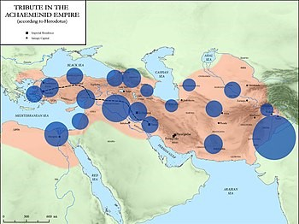

Slide 8
Macedonian Invasion
Introduction
Macedonia is a traditional region of Greece, comprising the north-central portion of the country.
The Greek conquests of India took place in the years before the Common Era, and a rich trade flourished between India and Greece, especially in silk, spices, and gold.
The Greeks invaded India several times, starting with the conquest of Alexander the Great between the years 327 to 326 B.C.E.
Alexander left Greek troops in Taxila (today’s Pakistan) where they governed the region until 316 B.C.E.
Later Seleucus I Nicator, one of Alexander’s generals, invaded today’s Pakistan and Punjab in 304 B.C.E., founding the Seleucid dynasty
From 180 B.C.E. to 10 C.E. the Greek empire expanded the Greco-Bactrian dynasty into northwest and northern India.
Their rule of the region ended with the Scythians and Kushans.

Slide 9
Condition of india at that time
Political Condition
At that time, there was not any mighty empire in India and the whole country was divided into several small republics and monarchical states which were constantly fighting with one another.
Across the Beas River the strong Magadhan Empire had neither the will or time to intervene in the political Change s occurring in the states lying to the west
Ambhi’s Kingdom
The kingdom of Taxila lay between the river Indus and Jhelum. It was ruled by Ambhi who was the sworn enemy of his neighbouring ruler Porus.
Porus’s Kingdom
Porus ruled over the territory which lay between the Jhelum and the Chenab. He maintained a strong army which fought well against Alexander.
The Magadhan Empire
To the east of the Beas lay the mighty empire of Magadha which was ruled by the Nandas who had a huge powerful army consisting of 2,00,000 foot soldiers , 60,000 horses, 1,000 to 6,000 elephant and 2, 000 four-horse-drawn chariots. Its capital city was at Patliputra.
Social Condition
People led a simple life. Thefts were uncommon.
However, the customs of Sati, polygamy and slavers were prevalent.
However, the Indians had made much progress in the field of art, architecture, literature and education.

Slide 10
Invasion by alexander the great
Conquests of Alexander (327-326 BCE)
In 327 B.C.E., Alexander the Great began his foray into Punjab
Alexander fought an epic battle against the Indian monarch Porus in the Battle of Hydaspes (326 BCE).
He made an alliance with Porus, and appointed him the Satrap of his own Kingdom.
East of Porus’ kingdom, near the Ganges River, the powerful kingdom of Magadha reigned.
Exhausted and daunted by the prospect of facing another formidable Indian army at the Ganges River, his army mutinied at the Hyphasis (modern Beas), refusing to march further East.
Effects of his Invasion
Alexander’s invasion was an unimportant event in the History of India and as such it did not leave any permanent mark on its civilization due to:
His Untimely Death
Short Stay in India, because of which the Greeks could not influence the civilisation of India
It was merely a border invasion, and did not affect the Indian Civilisation much.
Founding of the Mauryan Dynasty. No sooner did Alexander turn his back, all his Indian territories were occupied by Chandragupta Maurya and thus even the last vestiges of the Greek invasion were obliterated.

Slide 11
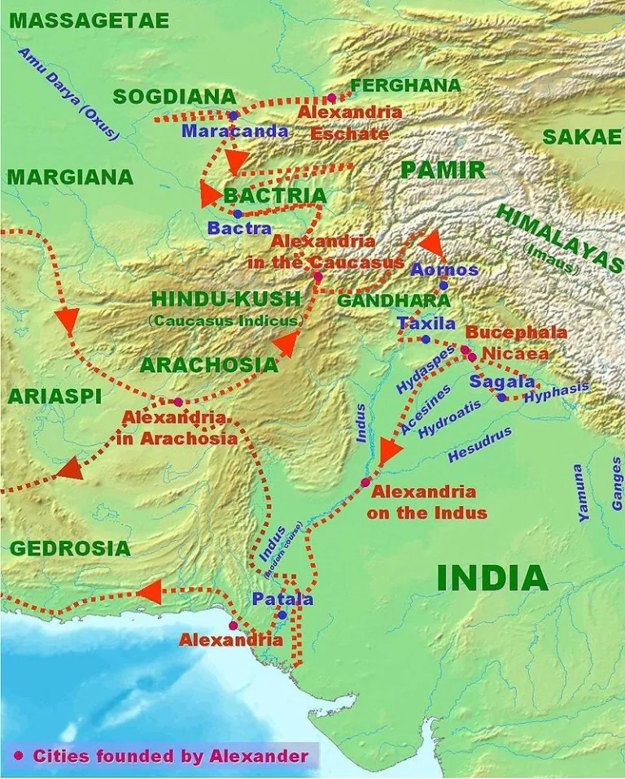

Slide 12
Indirect consequences of alexander invasion
It helped in the Founding of the Mauryan Dynasty
Alexander’s invasion had reduced the strength of the various states as well as the warlike tribes of the Punjab, so that it became quite easy for Chandragupta to subdue them
It helped in promoting India’s Unity
One significant result of these petty state and warlike tribes being crushed by Alexander was the task of establishing a strong empire became too easy
Enhanced Relations with Western Countries
Alexander’s invasion opened four new routes between India and Europe so that India could now have direct relations with the European countries.
The discovery of these routes also encouraged trade.
Several Indian traders, artisans and religious scholars went to other countries and some people came to India from other countries
Help in building Indian Chronology for subsequent Events.
Alexander’s invasion helped in the construction of the Indian history.
He invaded India in 326 A.D. a date which helped us a lot in determining the Indian chronology.
Indian texts especially the Puranas have ignored to record events in chronological order.
Megasthenes and other Greek writers have written a lot about the contemporary Indian society. Their descriptions have proved valuable in this respect.
Thus, Historians who accompanied Alexander have given an important information about the social and economic conditions of India.
Exchange of culture
The Indians learnt from the Greeks the art of making beautiful idols and coins.
The Gandhara School of Art is a direct consequence of the Greek art.
The Indians also learnt a lot from the Greek astronomers.
On the other hand, the Indians greatly influenced the philosophy and several Greeks embraced the Hindu faith.

Slide 13
Seleucid invasion (304 B.C.E.)
Seleucus I Nicator, founder of the Seleucid dynasty and one of Alexander’s former generals, invaded Pakistan and modern Punjab in northern India in 304 B.C.E. owe
However, Chandragupta forced an alliance with Seleucid.
Later, Seleucus also sent Megasthenes as his ambassador to Chandragupta’s court.
Megasthenes visited Pataliputra (modern Patna in Bihar state), capital of Chandragupta, often.
He wrote a detailed description of India and Chandragupta’s reign.
The Seleucids and the Mauryan emperors maintained cordial relations strengthened by frequent diplomatic exchanges until the fall of the Mauryan Empire.

Slide 14
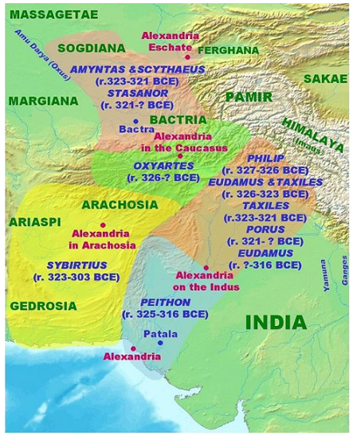

Slide 15
REFERENCES
www.insightsonindia.com
www.britannica.com
Pictures references- google images

