Slide 1
B.A.(GENERAL) 2ND SEMESTER
HISTORY OF INDIA 1206-1757 A.D
UNIT 3(CULTURAL DEVELOPMENT DURING THE MUGHALS)

Slide 2
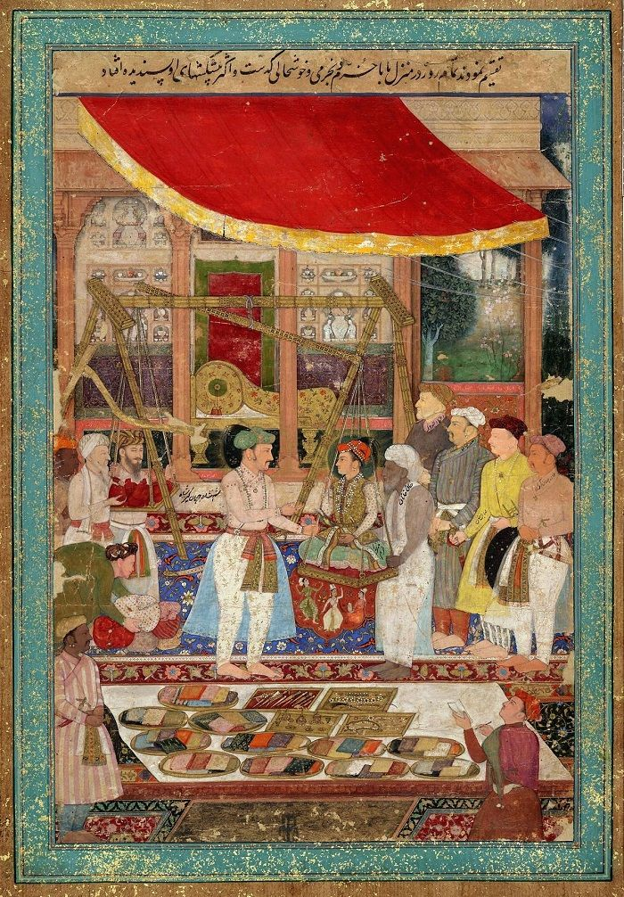
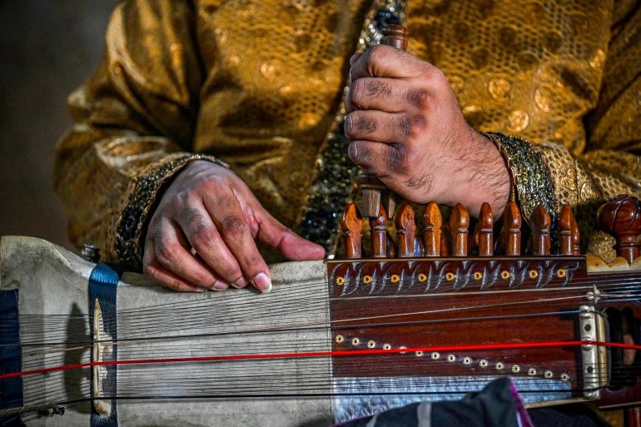
CULTURAL DEVELOPMENT UNDER THE MUGHALS
ART
The Mughals made a distinctive contribution in the field of painting. They introduced new themes depicting the court, battle scenes and the chase, and added new colours and forms. The revival began under Akbar. He organised painting in one of the imperial establishments (Karkhanas).
Here painters from different parts of the country came together; Jaswant and Dasawan were two of the famous painters at Akbar’s court. Indian themes and Indian landscapes became very popular, helping to free the school from Persian influence. Indian colours like peacock blue, Indian red, began to be used. Above all, the somewhat flat effect of the persian style began to be replaced by the roundness of the Indian brush, giving the pictures a three-dimensional effect.
European painting was introduced at Akbar’s court by the Portuguese priests. Soon principles of fore-shortening, whereby near and distant images could be placed in perspective, were adopted. Mughal paintings especially portrait painting reached a climax under Jahangir. His court patronized many of the best artists of the time like Bishan Das, Murad, Mansur and Bahazd.
While the tradition continued under Shah Jahan, Aurangzeb’s lack of interest forced the artists to disperse to various provincial capitals where local governors employed them. They helped in the development of painting in the states of Rajasthan and the Punjab hills. Another school of paintings which flourished at this time was the Deccan school which was encouraged by the Bijapuri kings.
Music: Tansen, the famous singer at Akbar’s court, is credited with having enriched the Hindustani school or north Indian style of music by composing many new melodies or rages. One of the most popular of these was the raja Darbari, believed to be Tansen’s special composition for Akbar. The Hindustani school of music had, by now, taken many features from Persian music. Jahangir and Shah Jahan continued patronizing this branch of cultural life. However, Aurangzeb in his later years, banished singing from his court. New styles of singing such as the khayal which had been developed in the Mughal court and the thermo became popular in the new centers which sprang up in the province and small kingdoms. However, music in all forms continued to be patronized by Aurangzeb’s queens in the harem and by the nobles.

Slide 3
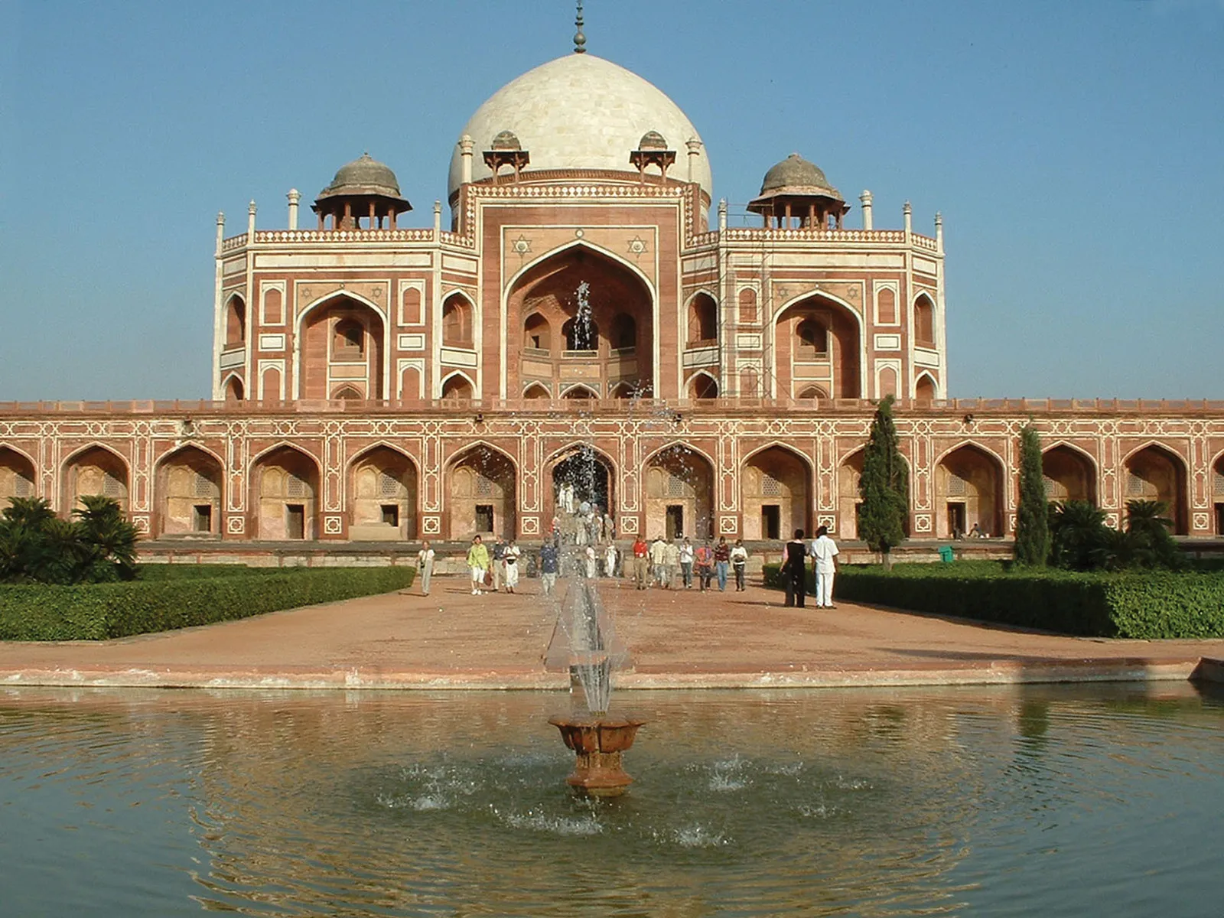
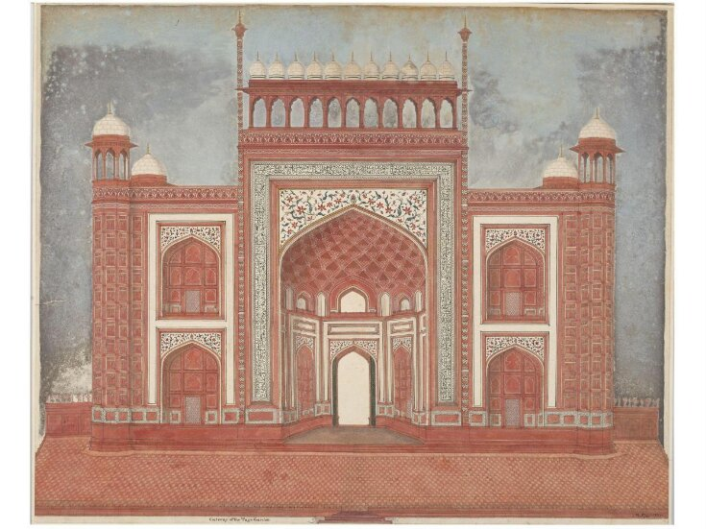
ARCHITECTURE
They had their own ideas about the construction of build ins by the free amalgamation of what was called the Mughal architecture which was in fact, the national Indian architecture of that age. In architecture, the Mughal period was not entirely an age of innovation and renaissance, but a continuation and culmination of processes that had their beginning in the later Turko- Afghan Period.
Hindu influence on architectural style lasted throughout the Mughal period and expressed itself in the narrow columns; Pilasters, corbel and other expressed itself in the narrow columns, pilasters, corbel and other ornamental features of Mughal buildings.
The salient features of the Mughal architecture, writes Sarkar’ are the pronounced dome, slender turrets and the corners, the bells supported on pillars and the Indo-Savaunic gate which takes the form of a huge semi-dome sunk in the front wall and bearing an admirable proportion to the building while the actual entrance is a small rectangular opening under the arch’.
The history Mughal architecture begins with Babur, who is said to have undertaken many building projects at Agra, Dholpur, Gwalior and other places. The adverse political circumstances didnot afford much opportunity to Humayun to undertake any significant architectural activity.
The new style of architecture (representing the combination of the best features of the indigenous and foreign styles) which may be called by the name of Mughal architecture had produced a profound effect on buildings all over the country, including those of the Rajput rulers of Rajasthan.
The style of Shahjahan’s principal edifices though based on session heritage is at the same time clearly distinguishable from Persian works by the lavish use of white marble and incomparable decoration. Another salient feature of his structures is the openwork tracery which ornaments the finest buildings, and the ‘apt combination of spacious designs with an almost feminine elegance’.
The Taj Mahal which took 23 years to be built is certainly one of the unrivalled beauties of the world. Another monument is the Red Fort. The Diwan-e-khas in it with its original ceilings of silver and its decorative scheme of marble gold and precious stones fully justified the Persian inscription which it bears.

Slide 4
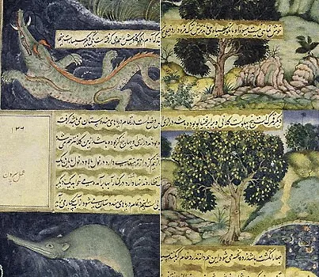
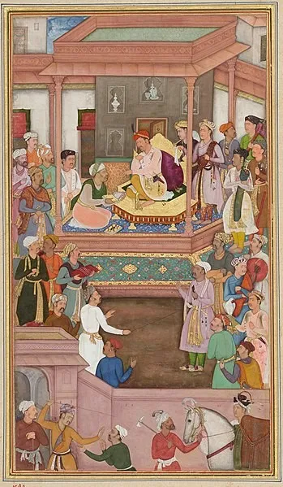
LITERATURE
Persian, Sanskrit and regional languages developed during the Mughal rule.
Persian was the language of administration in Mughal Empire.
The greatest contribution in the field of literature during the Mughal rule was the development of Urdu as a common language of communication for people speaking different dialects.
Babur wrote his autobiography, Tuzuk-i-Baburi in Turki language.This autobiography gives details of flora and afauna in India.
Babarnama(translation of tuzuk I baburi) was written in Persian by Abdul Rahim Khan.
Abdul Fazl has written Akbarnama (history of Akbar) and Ain-i-Akbari(administration book).
Jahangir hasitten his autobiography as Tuzuk-i-jahangiri.Mutamid khan has written biography of Jahangir as Iqbalnamah-i-Jahangir.
Shahjahan’s biography padshanamah was written by two author. They were Abdul Hamid lahori and Inayat Khan. Inayat khan wrote shahjahan namah. Persian literature was enriched by translations of Sanskrit works.
The Mahabharata was translated under the supervision of Abul Faizi, brother of Abul Fazal and a court poet of Akbar.
Dara Shikoh translated the Bhagavat Gita and Upanishads into the Persian language. His most famous work, Majma-ul-Bahrain.Badauni was bitter critic of Akbar. He translated Mahabharata into Persian as Razanamah.
Regional languages such as Bengali, Oriya, Rajasthani and Gujarathi had also developed during this period. From the time of Akbar, Hindi poets were attached to the Mughal court. The most influential Hindi poet was Tulsidas, who wrote the Hindi version of the Ramayana, the Ramcharitmanas.Jaganath Pandithraya , court poet of Shahjahan has written two Sanskrit books Ganga Lahari and Rasagangadharam.

Slide 5
REFERENCES
https://www.yourarticlelibrary.com/history/the-development-of-art-and-architecture-under-the-mughals-in-india/4099.
https://www.insightsonindia.com/medieval-indian-history/mughal-empire-including-later-mughals/literature-during-mughals/#:~:text=Babarnama(translation%20of%20tuzuk%20I,as%20Iqbalnamah%2Di%2DJahangir.
www.Wikipedia.com

