Slide 1
B.A.HISTORY(GENERAL)
1st SEMESTER( UNIT 4) – THE PALLAVAS

Slide 2
THE PALLAVAS
Pallava dynasty, early 4th-century to late 9th-century CE line of rulers in southern India whose members originated as indigenous subordinates of the Satavahanas in the Deccan, moved into Andhra, and then to Kanci (Kanchipuram in modern Tamil Nadu state, India), where they became rulers. Their genealogy and chronology are highly disputed. The first group of Pallavas was mentioned in Prakrit (a simple and popular form of Sanskrit) records, which tell of King Vishnugopa, who was defeated and then liberated by Samudra Gupta, the emperor of Magadha, about the middle of the 4th century CE. A later Pallava king, Simhavarman, is mentioned in the Sanskrit Lokavibhaga as reigning from 436 CE.
The Pallavas were the emperors of the Dravidian country and rapidly adopted Tamil ways. Their rule was marked by commercial enterprise and a limited amount of colonization in Southeast Asia, but they inherited rather than initiated Tamil interference with Ceylon (now Sri Lanka).

Slide 3
CONTRIBUTION TO ART AND CULTURE
The Pallavas supported Buddhism, Jainism, and the Brahminical faith and were patrons of music, painting, and literature. Their greatest monuments are architectural, in particular the Shore Temple, the various other temples carved from granite monoliths, and the Varaha cave (7th century; these collectively were designated a UNESCO World Heritage site in 1984) at Mamallapuram, once a flourishing port.
Mahendravarman I (reigned c. 600–630) contributed to the greatness of the Pallava dynasty. Some of the most ornate monuments at Mamallapuram, especially those dedicated to the Hindu god Shiva, were constructed under his rule (though born a Jain, Mahendravarman converted to Shaivism). He was a great patron of art and architecture and is known for introducing a new style to Dravidian architecture, which the noted art historian Gabriel Jouveau-Debreuil referred to as “Mahendra style.” Mahendravarman also wrote plays, including Mattavilasa-prahasana (c. 620; “The Delight of the Drunkards”), a farce in Sanskrit, which denigrates Buddhism.

Slide 4
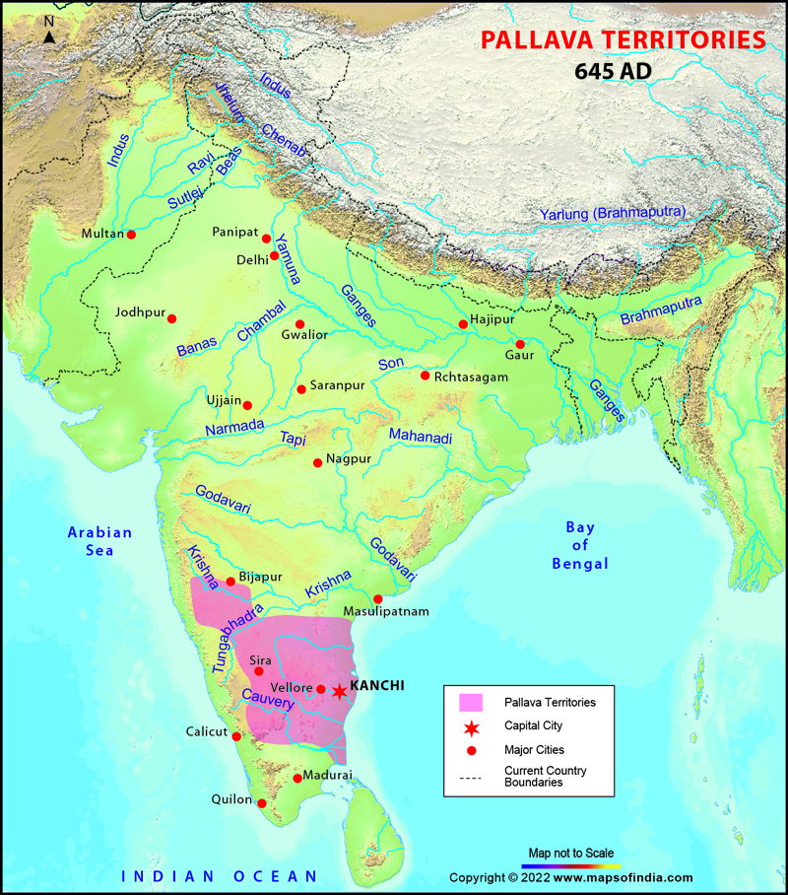
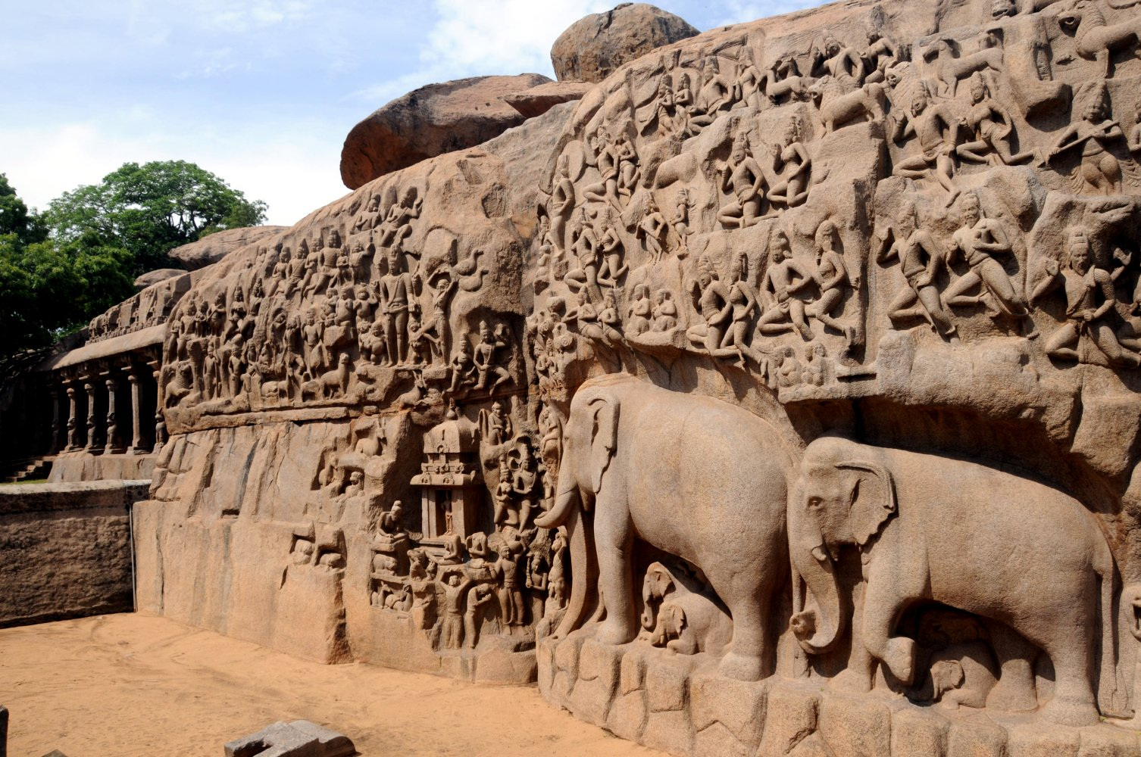
Culture and art
Mahendravarman’s reign involved constant battles with the Western Chalukya kingdom of Badami under Pulakeshin II. Mahendravarman’s successor, Narasimhavarman I, conquered some of the territory that was lost during numerous Pallava-Chalukya battles. Although he was able to recapture some of the Pallava land, the Pallavas were ineffective in withstanding military pressure from the Western Chalukya dynasty, which was eventually ousted by the Cholas. The Pallava dominions passed to the Chola kings about 880.

Slide 5
REFERENCES-
www.Britannica.com
https://www.insightsonindia.com
https://www.newworldencyclopedia.org.
www.Wikipedia.com
www.academia.edu

