Slide 1
B.A.HISTORY(GENERAL)
1st SEMESTER( UNIT 4) – THE CHOLAS

Slide 2
THE CHOLAS
Chola dynasty, Chola also spelled Cola, South Indian Tamil rulers of unknown antiquity, antedating the early Sangam poems (c. 200 CE). The dynasty originated in the rich Kaveri (Cauvery) River valley. Uraiyur (now Tiruchchirappalli) was its oldest capital.
ORIGIN OF CHOLAS
The reign of the Cholas began in the 9th century when they defeated the Pallavas to come into power. This rule stretched over for over five long centuries until the 13th century. However, around the 2nd century, the state Andhra has a Chola kingdom that flourished far and wide. The Early periods of the Chola rule saw the onset of the Sangam literature. Kantaman was one of the prominent rulers of this era. The medieval period was the era of absolute power and development for the Cholas. This is when kings like Aditya I and Parantaka I. From here Rajaraj Chola and Rajendra Chola further expanded the kingdom into the Tamil region. Later Kulothunga Chola took over Kalinga to establish a strong rule. This magnificence lasted until the arrival of the Pandyas in the early 13th century.

Slide 3
Some prominent pillars of the Chola Empire
Vijayalaya
The Chola Empire was founded by Vijayalaya. He took over the Tanjore kingdom in the 8th century and led to the rise of the mighty Cholas by defeating the Pallavas. Tanjore was hence made the first capital of the eminent Chola Empire.
Aditya I
Aditya I succeeded Vijayalaya to become the ruler of the empire. He defeated king Aparajita and the empire gained massive power under his reign. He conquered the Pandya Kings along with the Vadumbas and establishes control over the Pallavas power in the region.
Rajendra Chola
He succeeded the mighty Rajaraja Chola. Rajendra I was the first to venture to the banks of Ganges. He was popularly called the Victor of the Ganges. His new empire capital was called the Gangaikondacholapuram where he received the title of ‘Gangaikonda’. This period is referred to as the golden age of the Cholas. After his rule, the kingdom witnessed a widespread downfall.

Slide 4
Culture and Roots
The society and its culture saw massive developments in the reign of the Cholas. In this era, the temple was the main centre for all social and religious meetings. The surroundings of this region became a school for the folks where Holy Scriptures and the ancient Vedas were taught to students. This also was a secure place in times of warfare and political uproar. The societal structure at this time was divided amongst Brahmins and Non-Brahmins. Several gods and goddesses were worshipped with Shiva being a popular source of strength for the faithful. There are links of the relevance of the Chola Empire with the Trimula deity at Sri Venkateshwara temple. The religious roots of the Chola Empire go far back to this time. The Srirangam temple stands to be a highlight from this era. It was submerged in water for centuries and was renovated later to its former glory.
Art, religion and literature benefited greatly during this period. Several Shiva temples were built across the banks of the Kaveri river. Thanjavur still stands to be the biggest and tallest amongst all the temples in India of its time. The Tajore Brihadeeswara temple is adorned with natural colour paintings that are a feast for the eyes even today. Several of these sites have been classified as World Heritage Sites by UNESCO. These include the Brihadisvara temple, the Gangaikondacholisvaram and the Airavatesvara temples. Sculpting and art were also at an all-time high in this reign. Sculptures of gods and goddesses like Shiva, Vishnu and Lakshmi have been carved out of bronze and serve as a golden reminder of this period. Literature was another crucial highlight of this period. Not only did devotional literature take shape but Jain and Buddhist writings also got appreciation and recognition during this phase. The popular Nalayira Divya Prabandham from this period is a compilation of 4000 Tamil verses and is widely savoured by literary scholars even to this day.

Slide 5
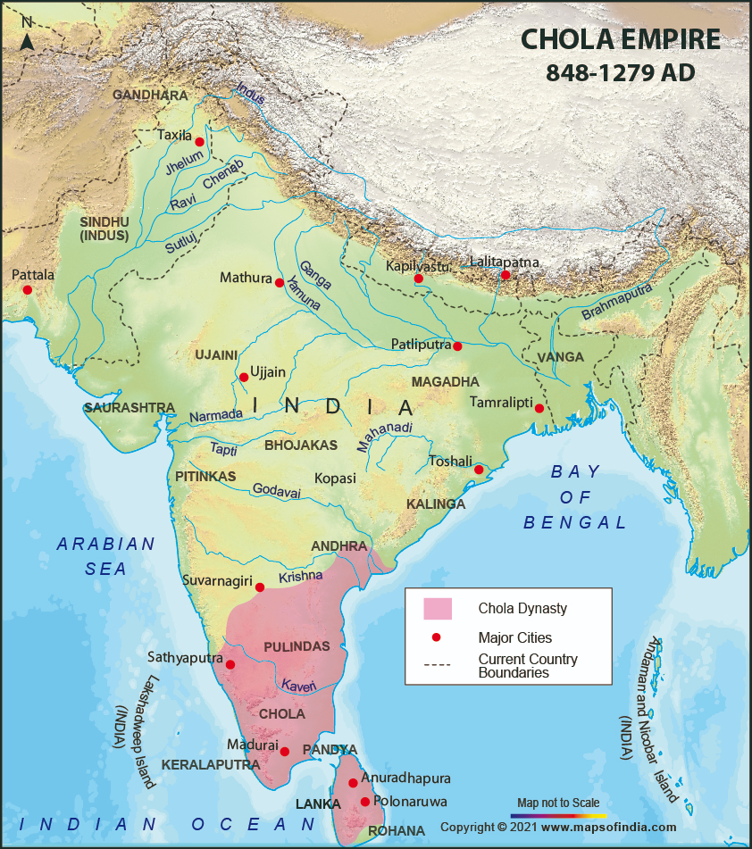
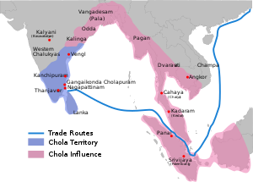

Slide 6
Administration and Governance
During the governance by the Cholas, the entire southern region was brought under the umbrella of a single governing force. The Cholas ruled in a sustained Monarchy. The Chola Empire consisted of the current day territories of Tiruchirapalli, Tiruvarur, Perambalur, Ariyalur, Nagapattinam, Pudukkottai, Vridhachalam, Pichvaram and Thanjavur districts of Tamil Nadu. Here the massive kingdom was divided into provinces which were known as mandalams. Separate governors were held in charge for each mandalam. These were further divided into districts called nadus which consisted of tehsils. The system of rule was such that each village acted as a self-governing unit during the era of the Cholas. The Cholas were ardent patrons of art, poetry, literature and drama; the administration was seen investing in the construction of several temples and complexes with sculptures and paintings. The king remained the central authority who would make the major decisions and carry out the governance.
Thus, the Cholas and their reign mark a remarkable period of medieval history that saw a massive cultural spurt along with a growth in civilization and its meaning. It symbolizes not only a period of rapid advancement but also a magnificent time to look back at and learn from.

Slide 7
REFERENCES-
www.Britannica.com
https://www.insightsonindia.com
https://www.newworldencyclopedia.org.
www.Wikipedia.com
www.academia.edu

